Slide 1
Quasar Stats & Reverberation Mapping
Hugh McDougall
May 2025, University of Southern Queensland

Slide 2
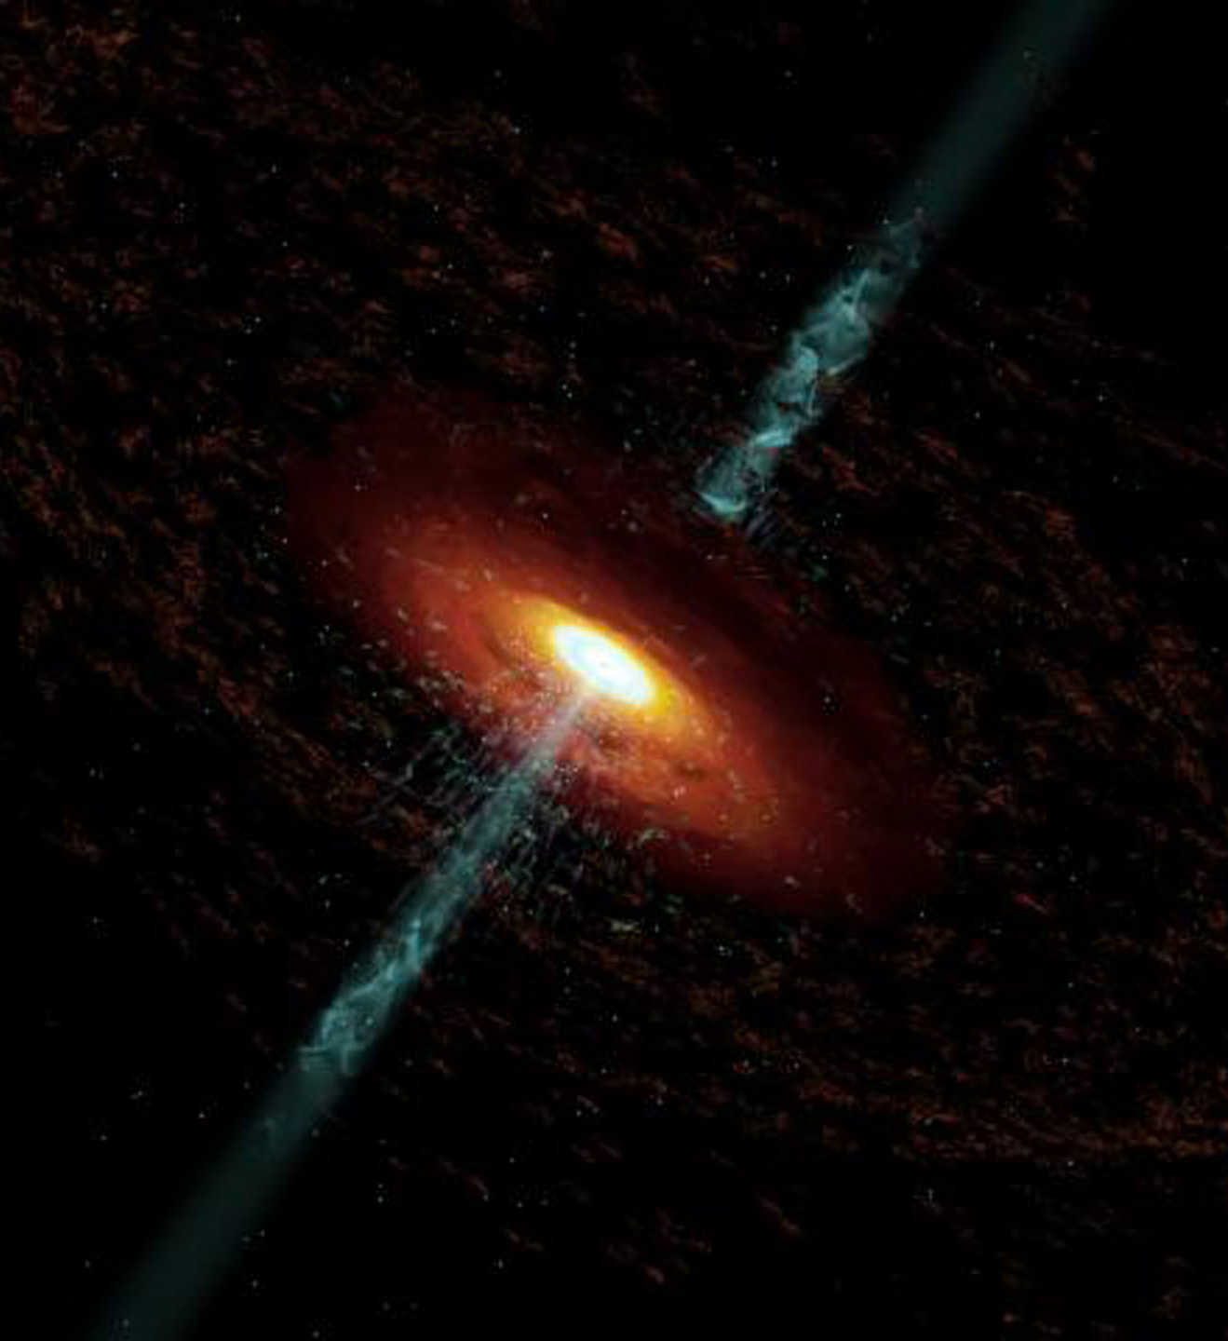
About Me
(Nearly) 2nd Year PhD Student at UQ
My Work:
Active Galactic Nuclei / Quasar – Mass Estimation
Bayesian Stats + Modelling
Gaussian Processes
Modern Numerical Tools - JAX / NumPyro
My Work
I was here a few months ago for Stars and Planets!
Me
My Cat

Slide 3
My Background
Me
Cosmology
Exoplanets
Large-Scale Structure of Universe
Stats
AGN
Reverberation Mapping
Telescope Image Processing
Dark Energy
Gaussian Processes
General Relativity
Stellar
Astrophysics
Prof Tamara Davis
Stats Methods
Dr Benjamin Pope
Supernova Cosmology
Radio Astronomy

Slide 4
The Hierarchy of Modelling
Physics Model
What are we seeing?
Statistics How do we describe this with maths?
Numerics
How do we calculate this?
Results
LITMUS – Modern Reverberation Mapping Software
What is Reverberation Mapping?
RM Benchmark / Statistical Re-Analysis
Today’s Talk

Slide 5
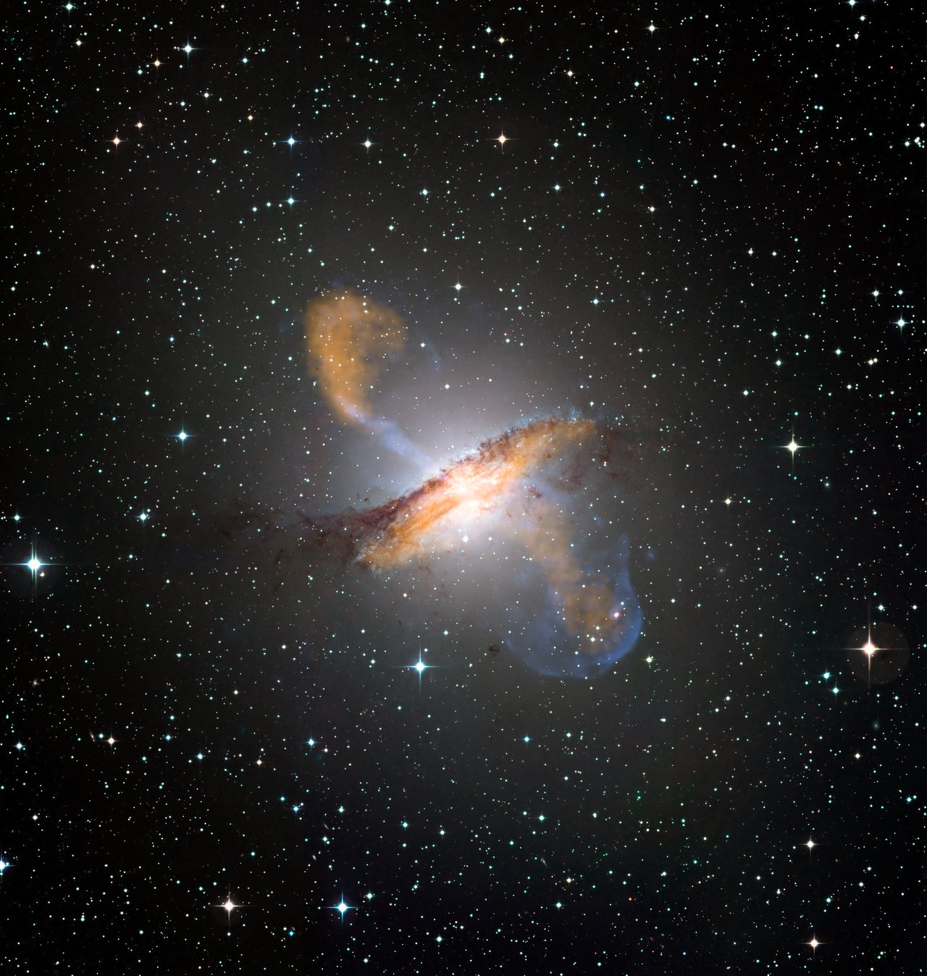
Part 1 Reverberation Mapping

Slide 6
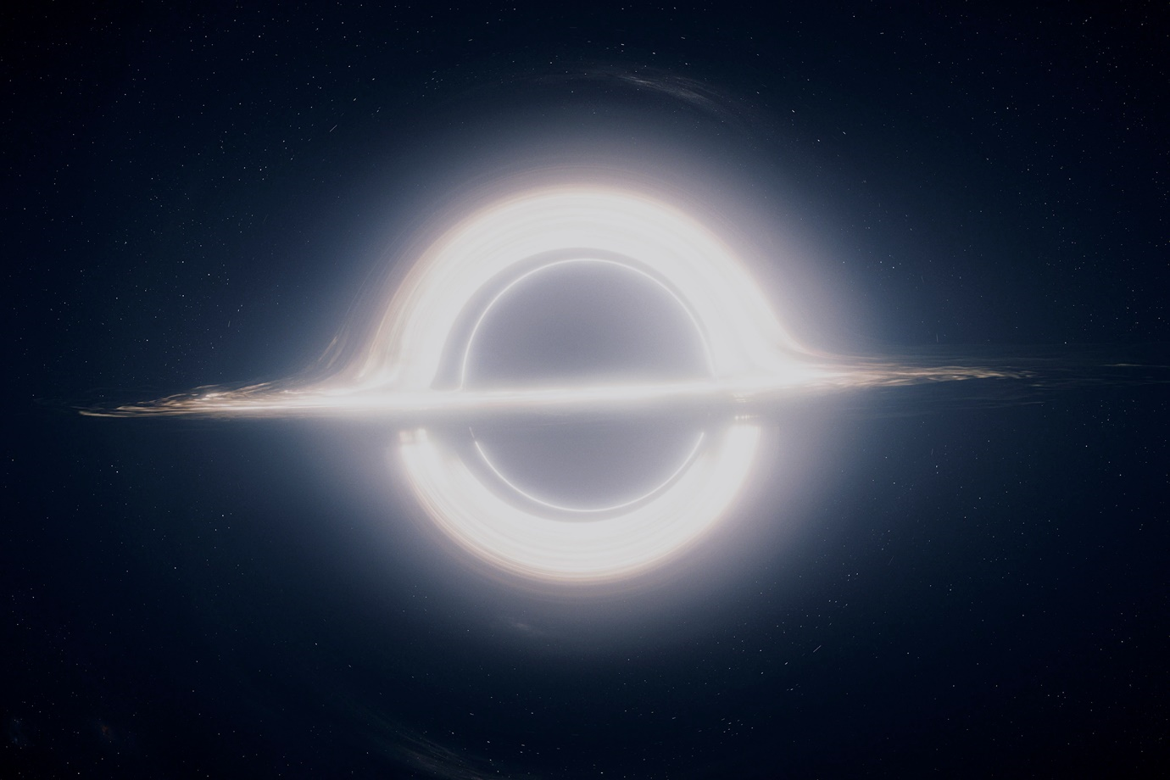
Supermassive Black Holes (SMBH)
Super-Massive Black Holes act as Galactic Nuclei
Co-Evolve with their host galaxies
Can’t understand galaxies without understanding SMBH

Slide 7
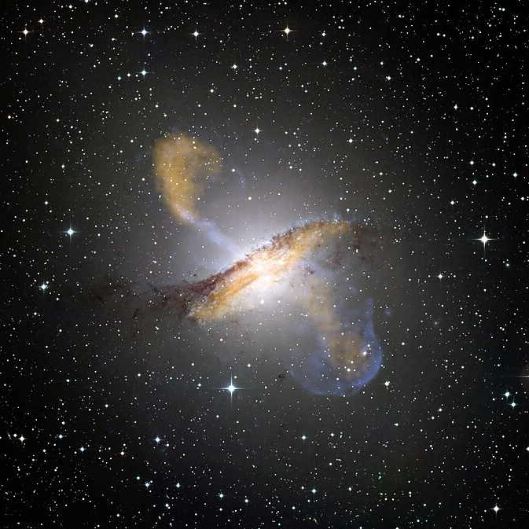
AGN Feedback – Vital to Galaxy Formation
Gas
Gravity
Accretion
Disk
AGN Turns On
Galaxy Merger, New Fuel
Radiation Pressure
Star Formation Quenched
Gas Disperses
AGN Turns Off

Slide 8
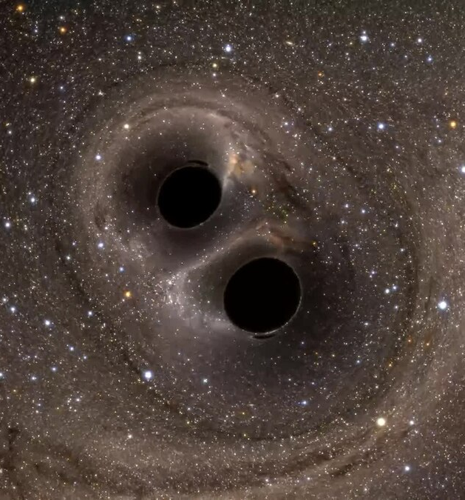
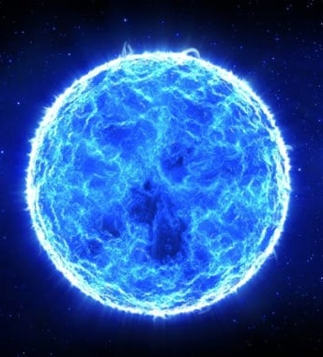
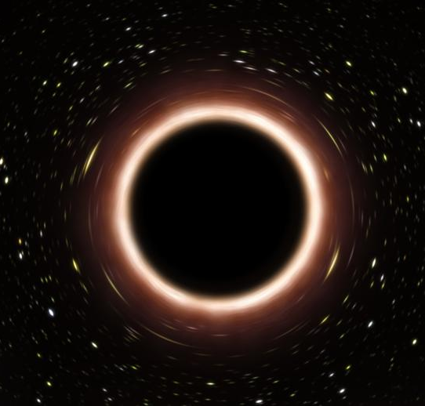
SMBH Formation & Growth Still An Open Question
Small Black Holes Merging?
Giant Ancient Stars?
Primordial Black Holes?

Slide 9
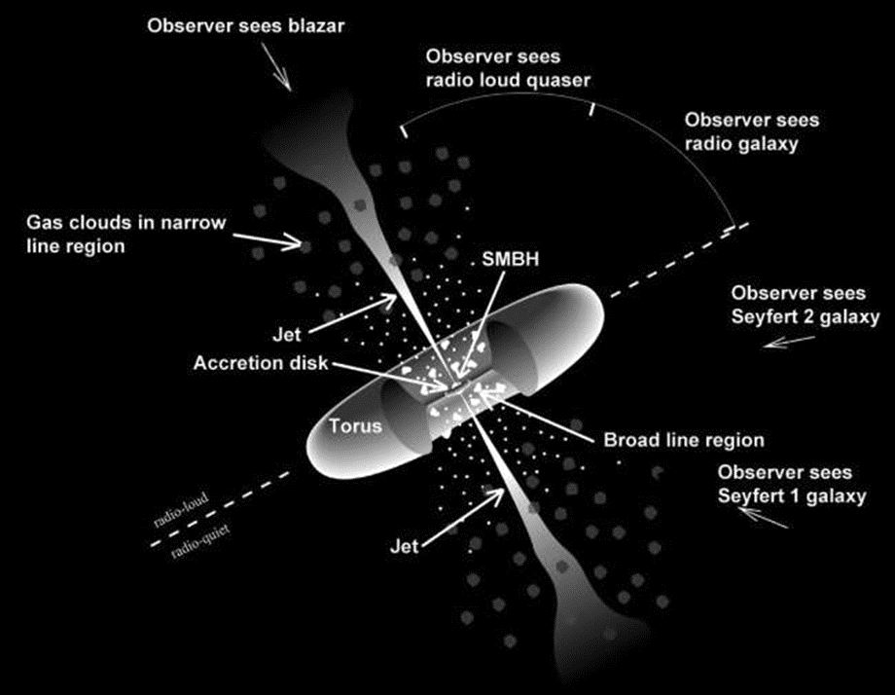
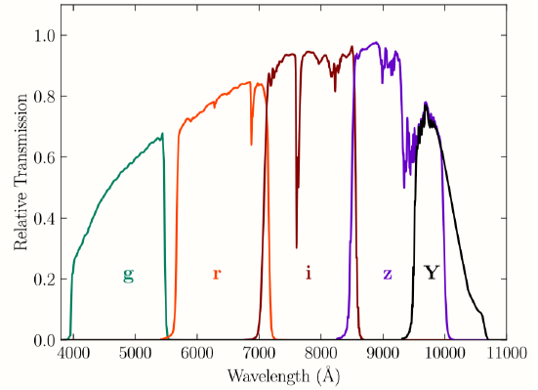
Reverberation Mapping
Complex geometry forms around AGN
Different angles means different parts visible
Single explanation for many strange in-sky objects
Broad line region (BLR) in tight orbit around SBMH
Captures + re-emits light as emission lines
Lines heavily doppler broadened from high velocity
$$M=\frac{\left\langle f\right\rangle R_{BLR}\left\langle v_{BLR}^{2}\right\rangle }{G}$$
Accr. Disk Continuum
BLR
Spectroscopy

Slide 10
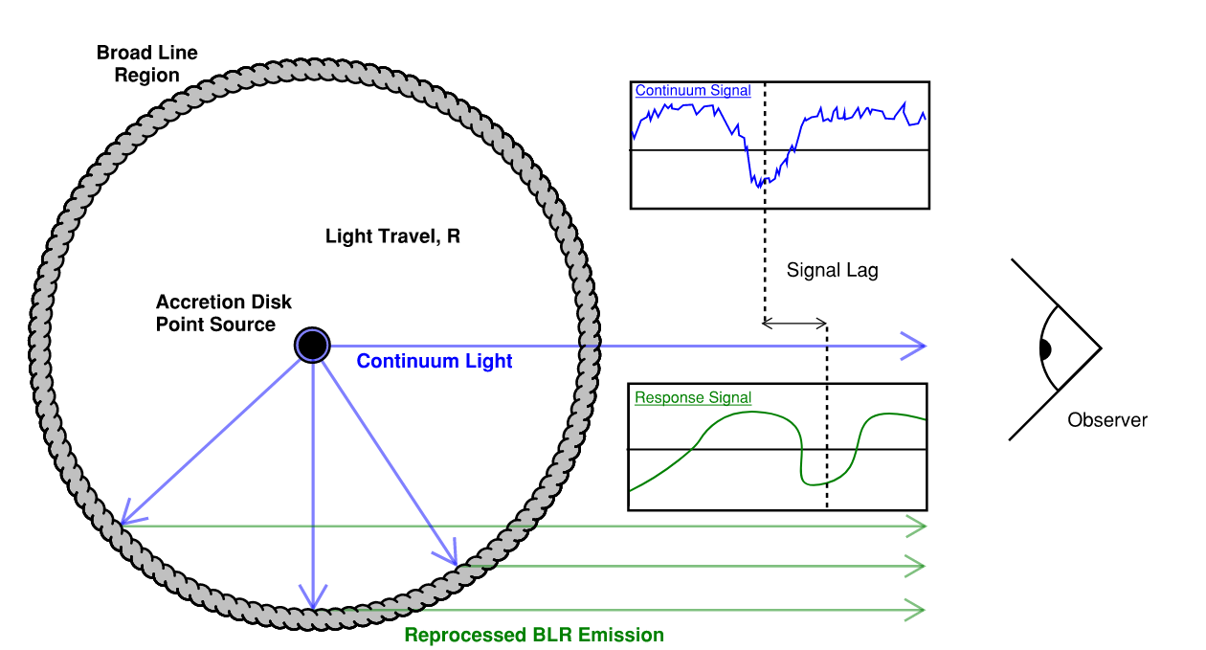
Reverberation Mapping
Accretion disk flickers
Photometry
Flickers “echo” off cloud as doppler broadened lines
$$R=c⋅Δt$$
Lag of echo is ruler for system size
Spectroscopy
$$R_{BLR}=c⋅Δt, M=\frac{\left\langle f\right\rangle R_{BLR}\left\langle v_{BLR}^{2}\right\rangle }{G}$$
Notes:
- Add mass eqn

Slide 11
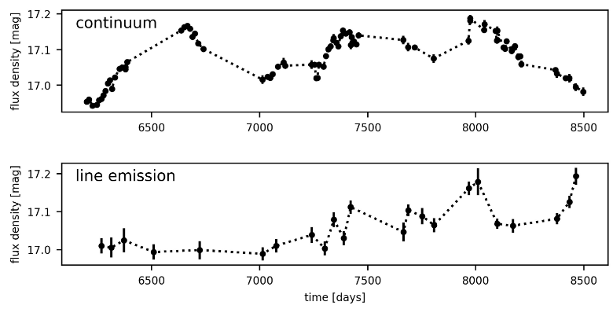
The Old Way - Interpolation
Interpolate between measurements, slide light-curves back and forth until they match.
Simple non-parametric stats model

Slide 12
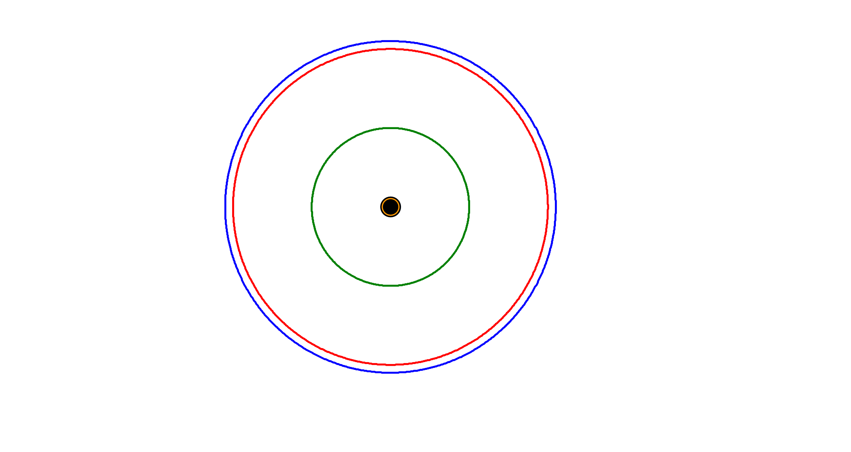
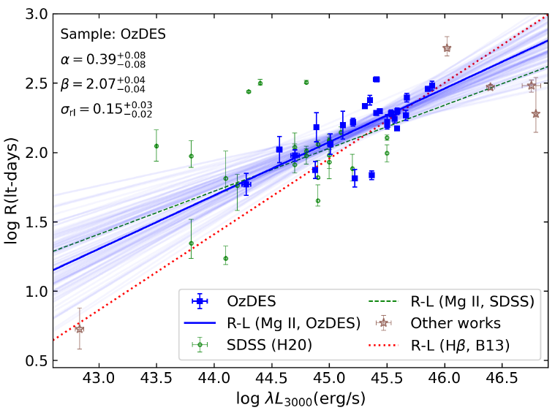
R-L Relationship – Tully Fisher for AGN
vv
Different Lines Emit From Different Radii
MgII
H$β$
CIV
Reverberation Mapping on a small number of sources
Tune R-L Relationship
Estimate $R_{BLR}$ for many more sources

Slide 13
Part 2 RM Benchmark

Slide 14
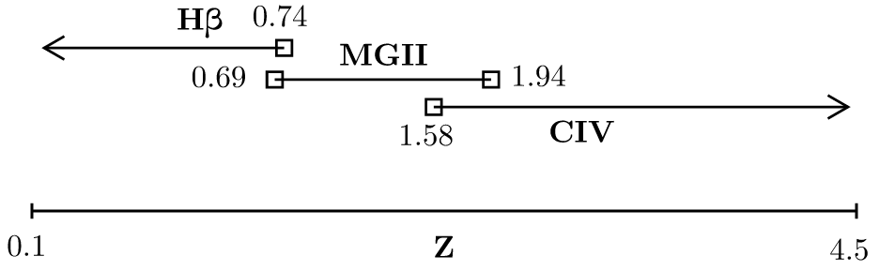
Modern RM Surveys – Industrial
Old Way: $≤$A dozen AGN at a time, dedicated bespoke measurements
New Way: “Industrial Scale” RM, $≈1000$ sources over wide redshift range. “Statistically significant sample”.
Notes:
Change to include example signal, remove line-Z graph and split into its own slide

Slide 15
Modern RM Surveys – Signals
Long Baseline, Large Volume, but…
Seasonal Gaps
&
Lower SNR

Slide 16
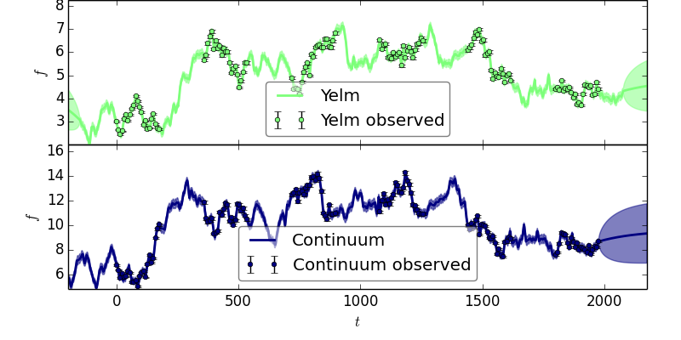
New Stats: Bayesian + Gaussian Processes
Zu, 2013
arXiv:1202.3783
AGN variability is a damped random walk. The software JAVELIN does lag recovery using this model in a full Bayesian sense.
Notes:
Pair this down?

Slide 17
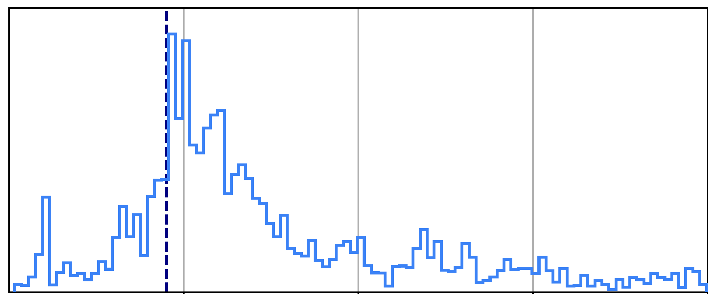
The Aliasing Problem
Old Method (ICCF)
Too Vague to Use
Lag Posterior Distribution
True Lag, 180 d
New Method (JAVELIN)
Aliasing Peaks Can Lead to False Positives
Notes:
v

Slide 18
The Aliasing Problem – Why?
Lags with No Overlap Can’t Be Falsified – “Good Enough” Fit

Slide 19
Different Surveys: Different Philosophies
Rigorous Stats Models
Stringent Quality Cuts
Don’t publish anything you aren’t certain in
Approximate models
Publish as much reasonable data as you can
Publish if you’re more certain than not
8% acceptance rate
25% acceptance rate

Slide 20
The Problem
First generation of industrial scale surveys done
Decades of historical data
No clear agreement on processing
Goal: Figure out what we can do with the data

Slide 21
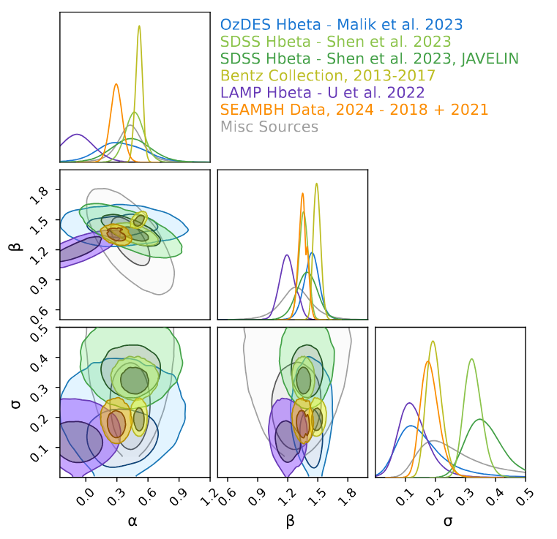
Problem 1 – How to Use Historical Data?
H$β$ | MgII | CIV
OzDES + SDSS Plus…
Barth et al. (2013) | Code & Welch (1982) | De Rosa et al. (2015)
Bentz et al. (2009) | Czerny et al. (2019) | Grier et al. (2019)
Bentz et al. (2013) | Lira et al. (2018 | Hoormann et al. (2019)
Bentz et al. (2014) | Metzroth et al. (2006) | Kaspi 2021
Bentz et al. (2016a) | Shen et al. (2016) | Lira et al. (2018)
Bentz et al. (2016b) | Shen et al. (2019) | Metzroth et al. (2006)
Fausnaugh et al. (2017) | Zajacek (2020) | Peterson et al. (2005)
Hu et al (2021) | Zajacek (2021) | Shen et al. (2019)
Li et al. (2021)
Lu et al. (2016)
Pei et al. (2014)
Rakshit et al. (2019)
U et al. (2022)
Zhang et al. (2019)
Some surveys are in tension. We can’t blindly combine them: we need to check

Slide 22
Problem 2 – SDSS Data Is Noisy
Have to find the sub-sample of SDSS data that we can trust as strongly as OzDES

Slide 23
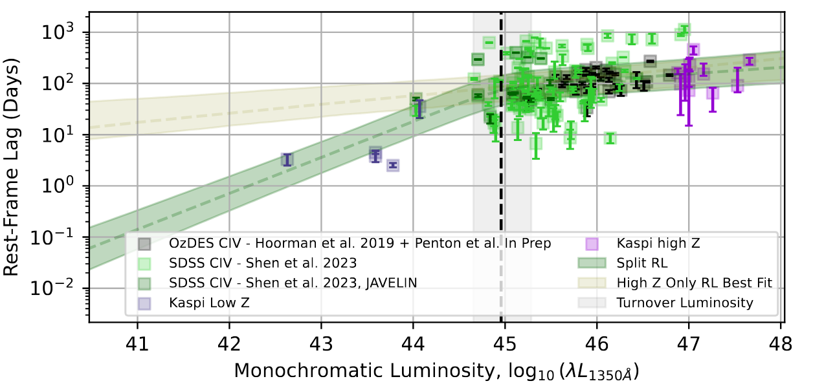
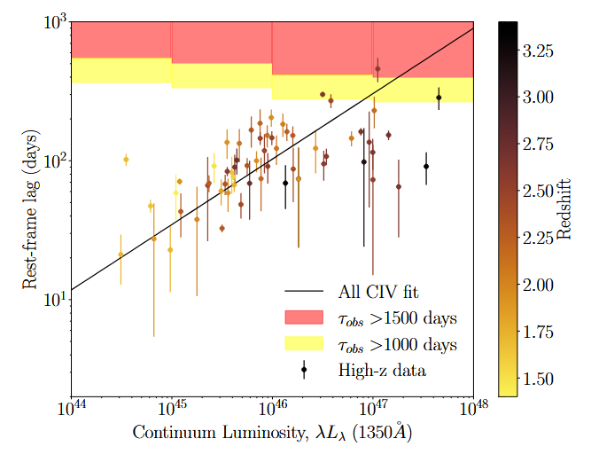
Problem 3 – CIV Lags Flattening Out?
Upper limit on how long of a lag we can see. Need to model this selection effect.

Slide 24
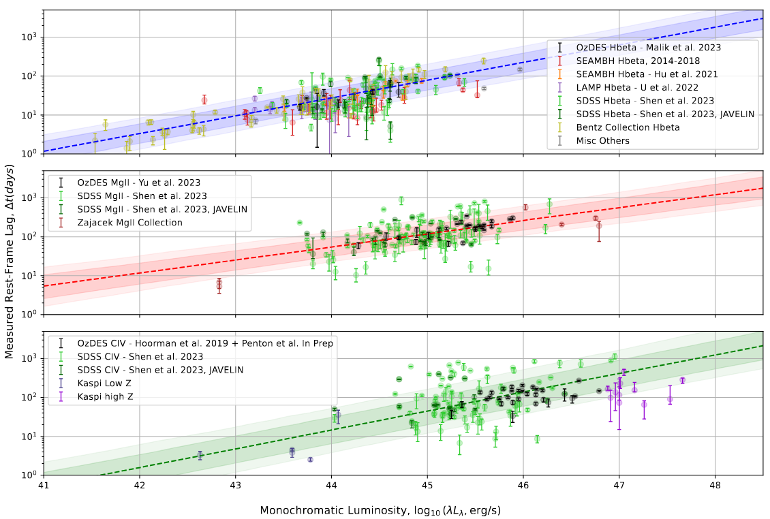
Result: Gold Standard R-L Relationships
Best ever H$β$ and MgII R-L relationships ever
Tuned for high redshift sources
First reliable CIV R-L Relationship

Slide 25
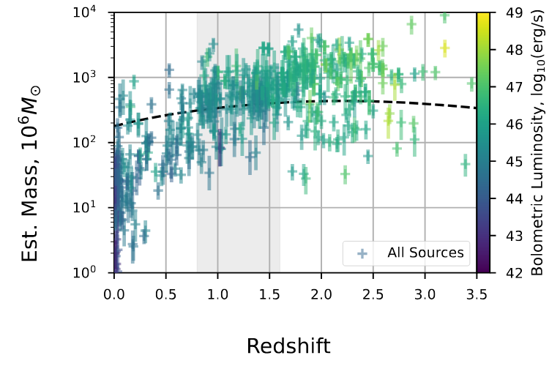
Doing Physics With Results: Single Epoch Masses
Gold standard R-L relationships let us get masses from non-RM OzDES data!
Single homogenous data source
$⇒$ we can do population statistics
Interesting Finding:
Heaviest AGN become less common towards recent times (cosmic downsizing)

Slide 26
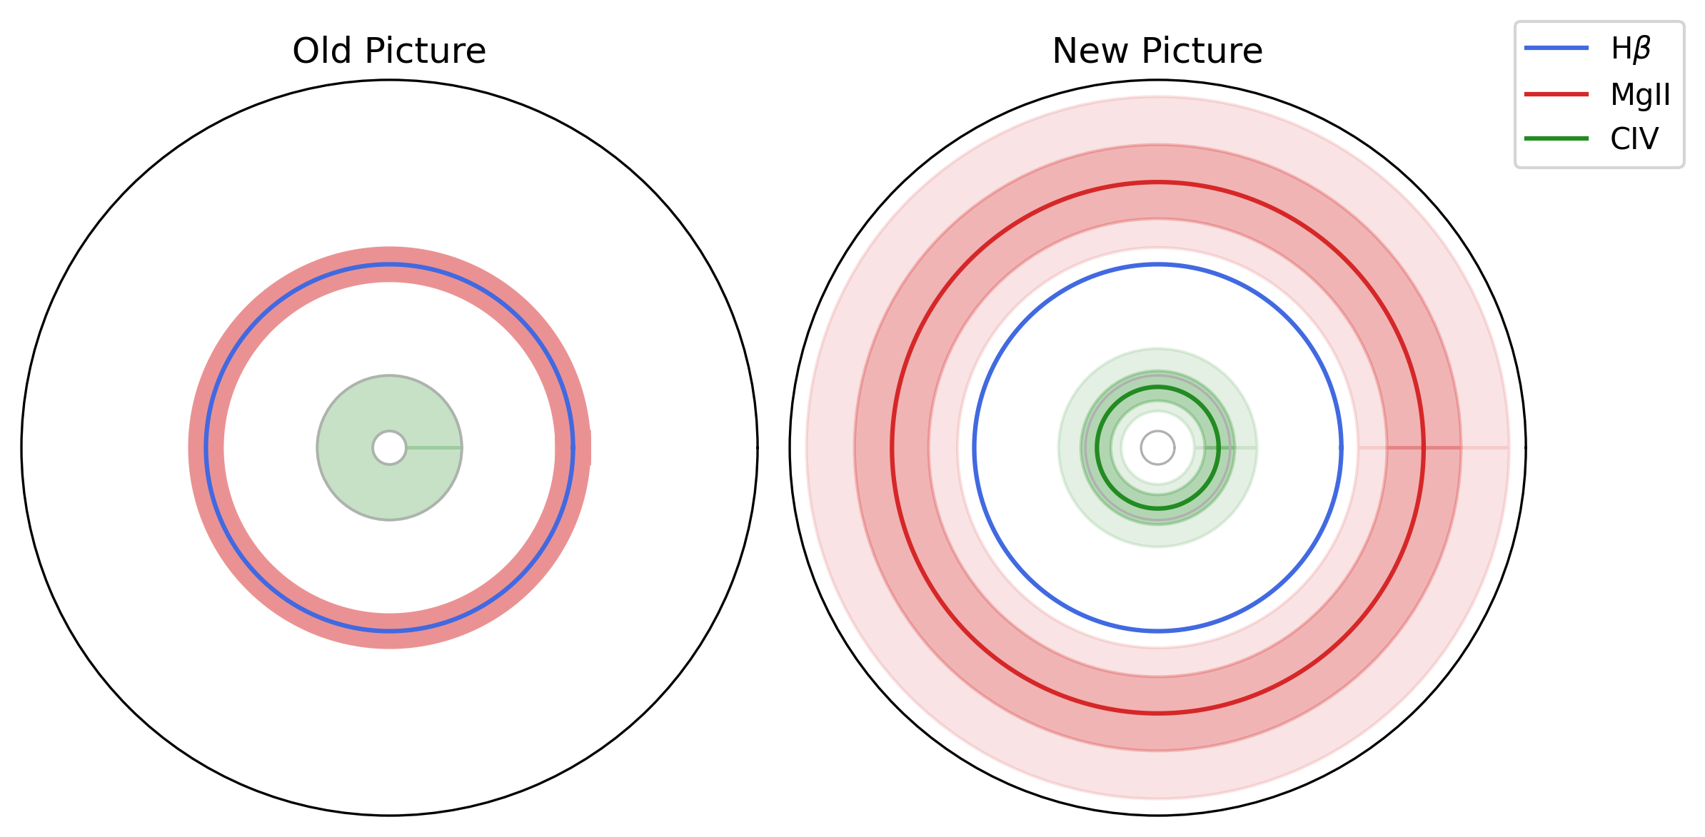
Scale of Lags / Radius Tells us About BLR Structure
Old Picture: MgII and H$β$ cospatial
New Picture: MgII Further Out

Slide 27
The Moral of the Story
This was just a linear regression
How did we get here? Unreliable Lag Recovery

Slide 28
Project 2 LITMUS

Slide 29
JAVELIN gets it Wrong
Lag Posterior Distribution from JAVELIN
Same Data
Same Physics
Same Statistics
Different Fitting Method
No Aliasing Peaks
True Lag Posterior Distribution
Notes:
v

Slide 30
What Went Wrong?
JAVELIN does fitting with emcee, but…
check the paper by Foreman-Mackey, 2015
emcee doesn’t work for multimodal distributions!

Slide 31
Reverberation Mapping is Hard
Complicated Numerical Problem: We need purpose-built tools
False Positive Lags are Hard to Identify:
We need statistically meaningful tests of results
Old Tools are Slow & Unwieldy: We need something fast

Slide 32
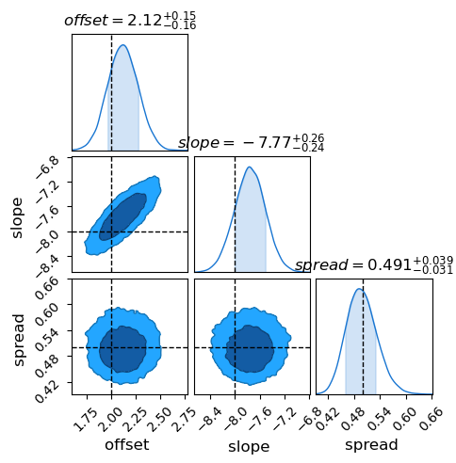
Screen For False Positives
Probability Density
Probability Mass (Evidence)
Integrates To
$$Z =∫P\left(θ\right) dθ$$
$$L\left(θ | D\right) × π\left(θ\right)$$
Compare Models

Slide 33
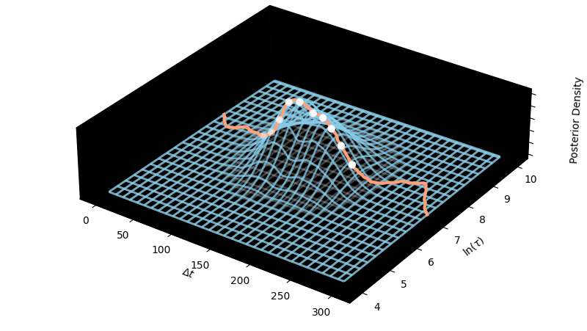
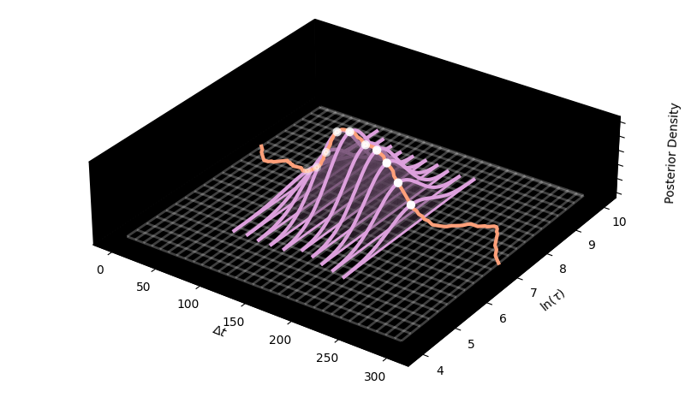
The Solution:
For a grid of lags, find best fit of all other parameters
Slice up domain into gaussians
Not an MCMC Engine: Integrate Nested Laplace Approximation (INLA)

Slide 34
The Solution:
Robustness
Purpose built for RM, handles all the numerical challenges of aliasing
Flexibility
Modular design allows for different stats + physics to be fit
Speed
New algorithm extremely fast, runs in < 1 min
Hypothesis Testing
Proper testing of false positives with Bayesian Evidence Ratios

Slide 35
Does it Work? Yes!
Successfully screens false positives on simulated signals
✅
❌
✅
❌
Model with Lag
Vs.
❌
Model without Lag
❌

Slide 36
What Now?
Observe AGN
Get Spectra + Light Curves
Measure Lag
Interpret Results
Is This Real?
Need More MgII Lags to Find Out

Slide 37
Thank You!
Questions?
https://hughmcdougall.github.io/
https://github.com/HughMcDougall/

Slide 38
LITMUS - Software
Programmed in Python, using:
JAX – Just in time (JIT) compiled language gives massive increase in speed, automatic differentiation (Autodiff) opens up entire array of new tools
NumPyro – Probabilistic programming language
TinyGP– Gaussian Process modelling package built in JAX

Slide 39
The OzDES RM Program - Papers
CIV
Hoorman 2019
Penton 2021
Penton 20??
Wrap-Up Paper
MgII
OzDES
RM
Yu 2019
Yu 2020
Yu 2022
Yu 2023
McDougall, 2025
H$β$
Malik 2022
Malik 2023

