Slide 1
The Brightest Black Holes Quasars In the Distant Universe
Hugh McDougall, UQ Astro, Pint of Science 2025

Slide 2
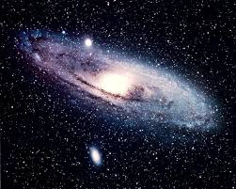
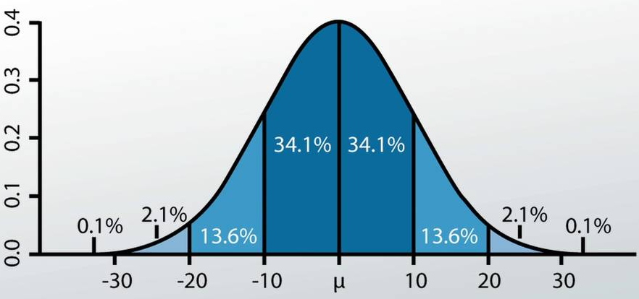
About Me: Hugh McDougall
(Nearly) 3rd Year PhD Student at UQ
Active Galactic Nuclei / Quasar – Mass Estimation
My Speciality: Astro-Statistics
Astronomy
Statistics

Slide 3
Show Of Hands: Who Knows…?
What a Black Hole is?
Where Black Holes come from?

Slide 4
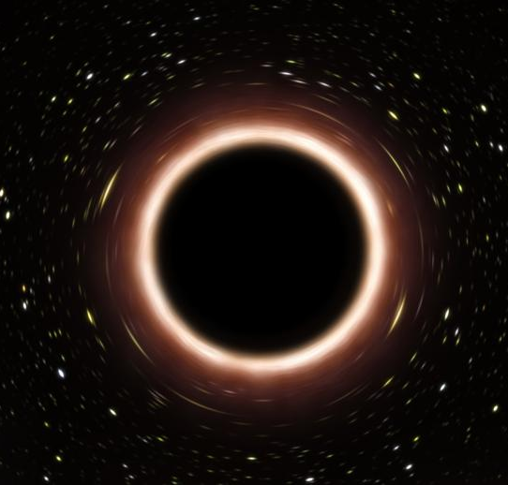
Black Holes: Simpler than Humans
Have opinions (unfortunate)
Economics
Middle Names
Neurology
Chemistry
Biology
G R A V I T Y
Favourite colours
Sinuses
Psychology
Fear of Public Speaking

Slide 5
Gravity Vs. Pressure: The Universal Tug-Of-War
Gravity Pulls Mass Together
Pressure Provides a Restoring Force

Slide 6
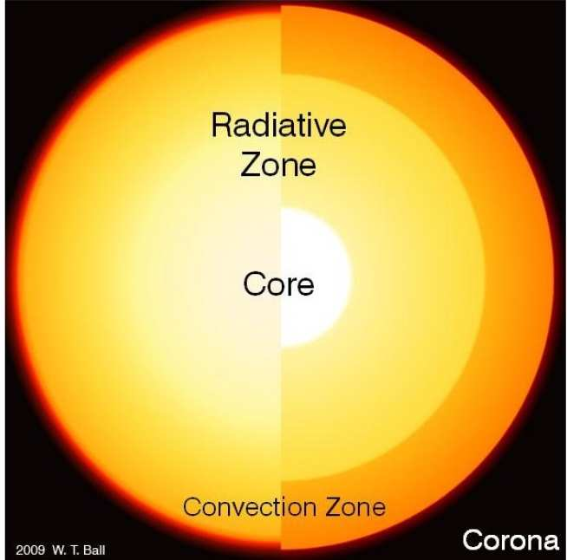
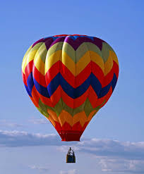
How Does The Sun Stay Up?
Electron Degeneracy Pressure
Gas Pressure
https://www.imperial.ac.uk/astrophysics/research/the-sun/solar-basics/
Radiation Pressure

Slide 7
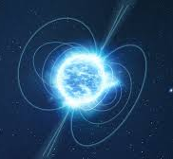
Massive Star
$$25 M_{⊙}$$
Heavy Star
$$4 M_{⊙}$$
Sun(ish) Star
$$1 M_{⊙}$$
White Dwarf
Neutron Star
Black Hole

Slide 8
Escape Velocity Higher than Speed Of Light
A Black Hole

Slide 9
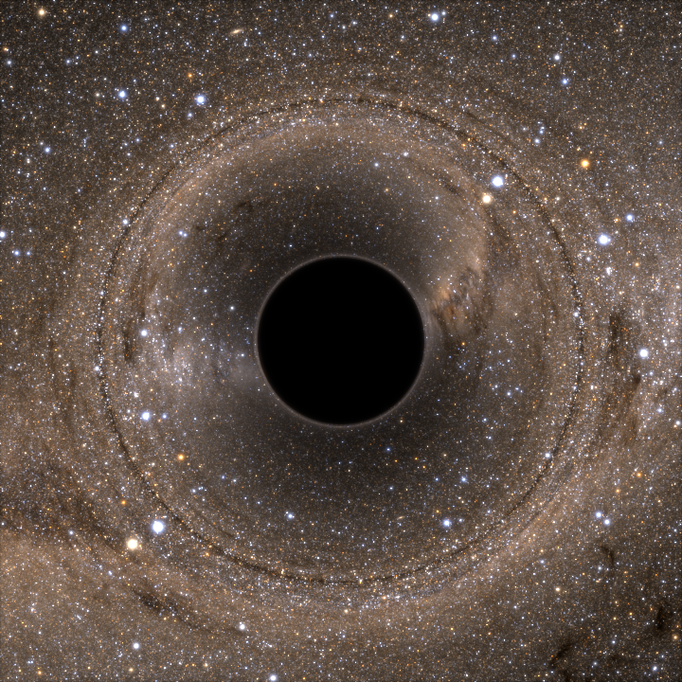
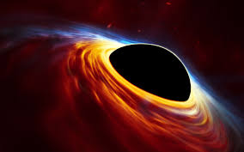
How Can We See them?
Lensing
Orbits
Accretion Disks
$≈$ 100 Million Stellar Mass Black Holes In Our Galaxy

Slide 10
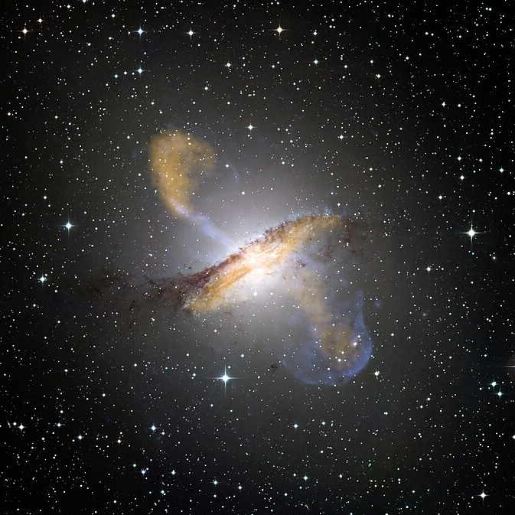
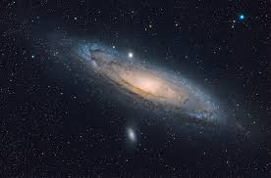
Let’s go Bigger (And Farther)
Andromeda
Centaurus A
Milky
Way
~2.5 Mill Light Years
~12.5 Mill Light Years

Slide 11
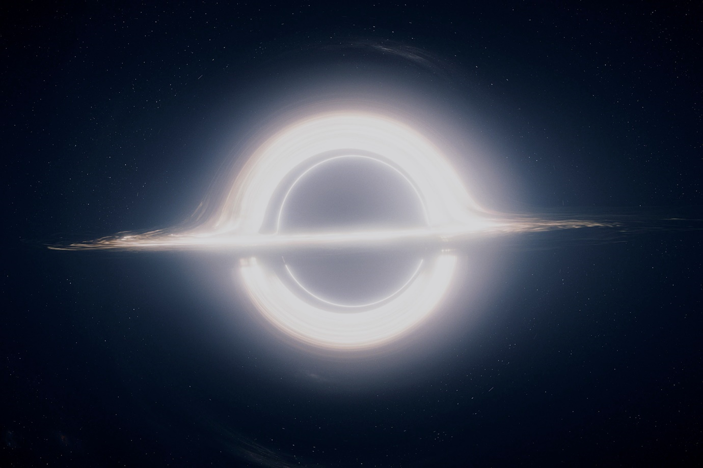
Centaurus A: A Super-Massive Black Hole
Simulation of a super-massive black hole from Interstellar (2014)
55 million times heavier than the sun
Matter sucked in, compacted into white-hot disk
Vortex creates radio jets
Artist's rendition of a zoomed-out quasar and its surrounding dust clouds

Slide 12
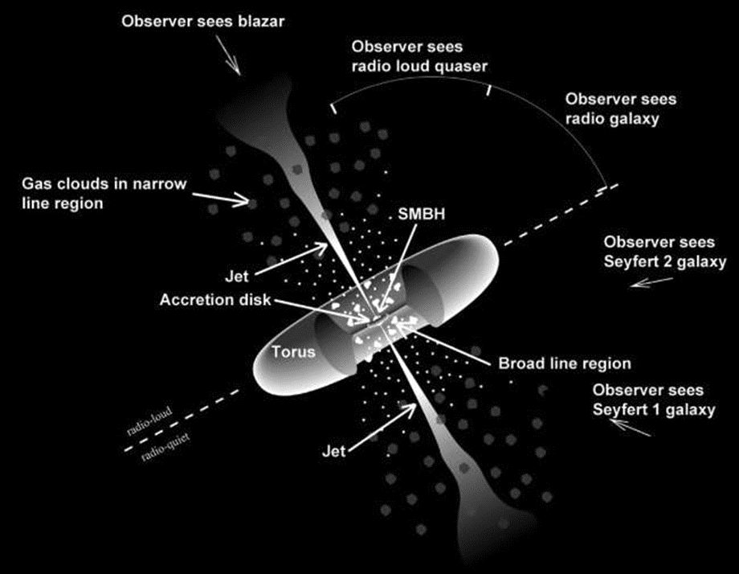
AGN – One Answer to Many Questions
Answered a lot of questions:
Quasars
Blazars Radio jet coming directly at us
Seyfert galaxies Glowing reflection of a quasar through a dust cloud
Radio galaxy: Can only see the radio-jets
These things are everywhere (~1% of galaxies)

Slide 13
AGN Feedback – Vital to Galaxy Formation
Gas
Gravity
Accretion
Disk
AGN Turns On
Galaxy Merger, New Fuel
Radiation Pressure
Star Formation Quenched
Gas Disperses
AGN Turns Off

Slide 14
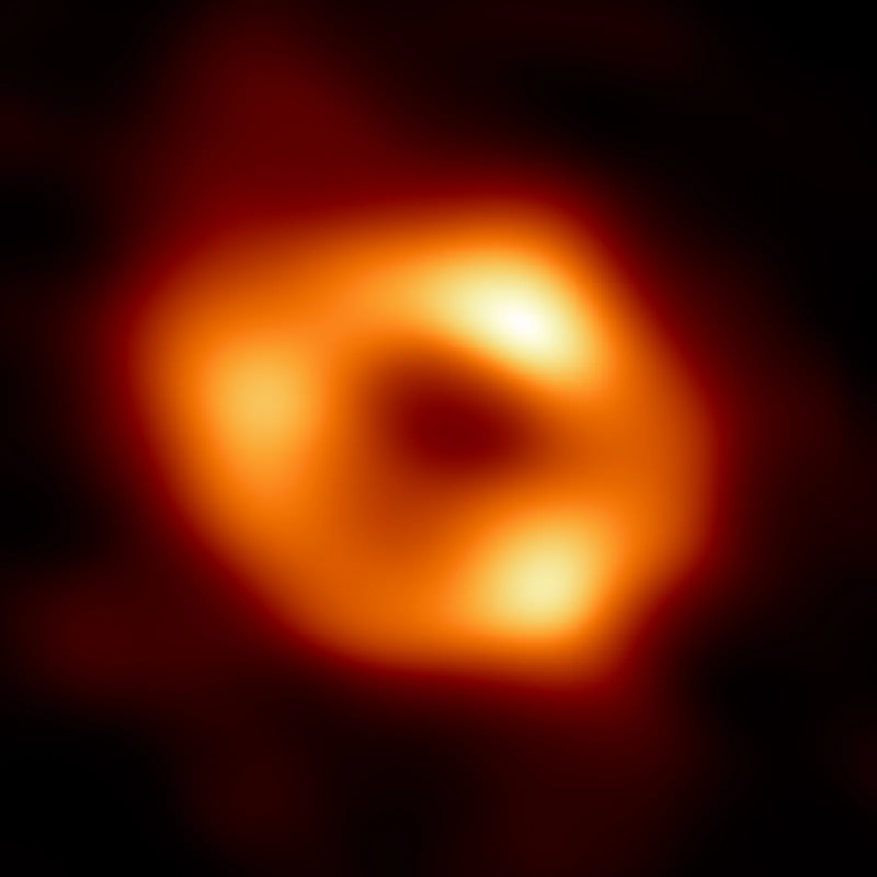
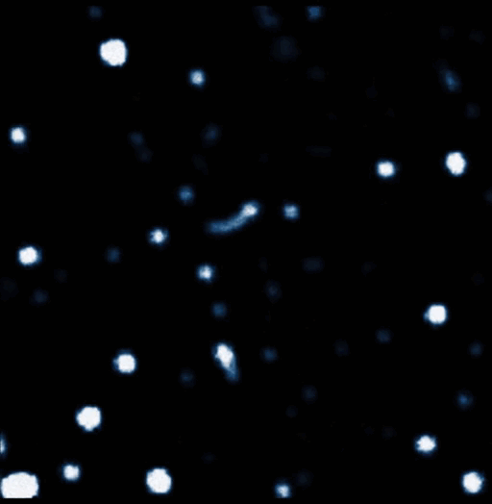
Sagittarius A*: Our Local SMBH
Photograph of Sgr A* (Event Horizon Telescope, 2022)
4.3 billion times heavier than the sun
Currently dormant, not a bright shining thing
Not going to eat us
Still only <1% of the Milky Way’s mass
≈27,000 light-years
Stars Tugged by the Gravity of Sgr A*

Slide 15
Why we Care When we look out into space we also look back in time
12.5 Million Lightyears Away
From 12.5 Million Years Ago
Quasars are bright enough to see very far away

Slide 16
Show Of Hands: Who Knows…?
Where Supermassive Black Holes come from?
We don’t know!

Slide 17
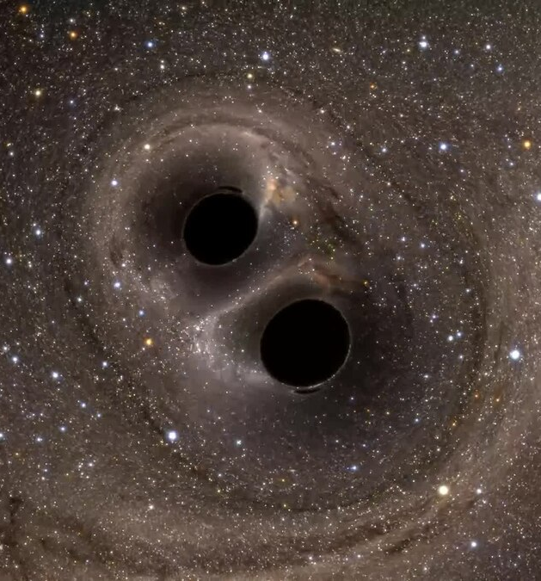
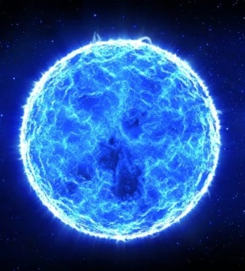
Why we Care Still open questions about how SMBH’s form
Small Black Holes Merging?
Giant Ancient Stars?
Primordial Black Holes?

Slide 18
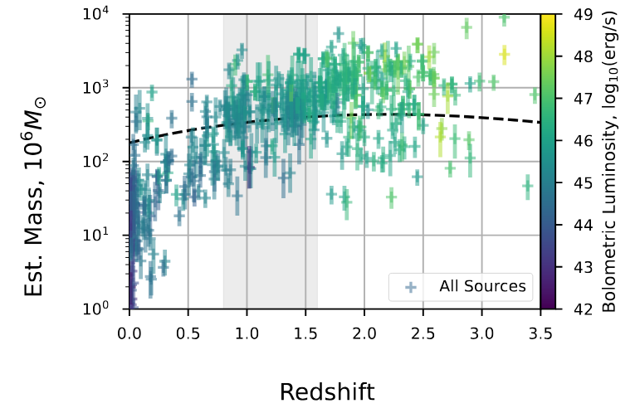
Different theories leave different fingerprints in the SBMH masses
We can play detective to find the truth

Slide 19
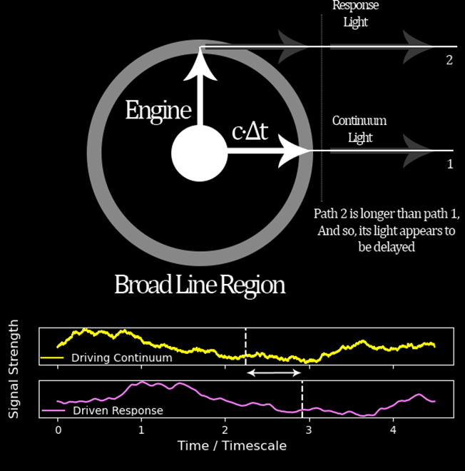
My Work: Reverberation Mapping
Distant quasars too small to see details
Can use light echoing around inside as a ruler
Can measure black hole masses out to incredible distances

Slide 20
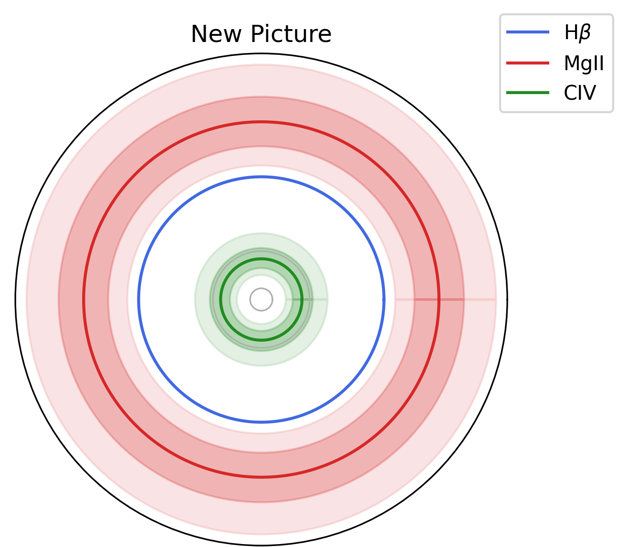
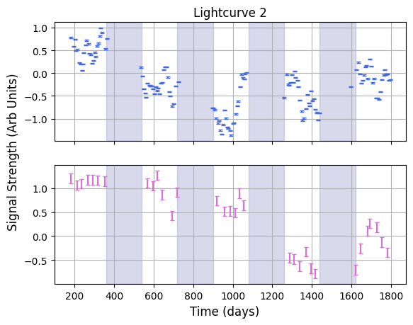
My Work: Reverberation Mapping
Listening for Echoes
“Picture” of the AGN

Slide 21
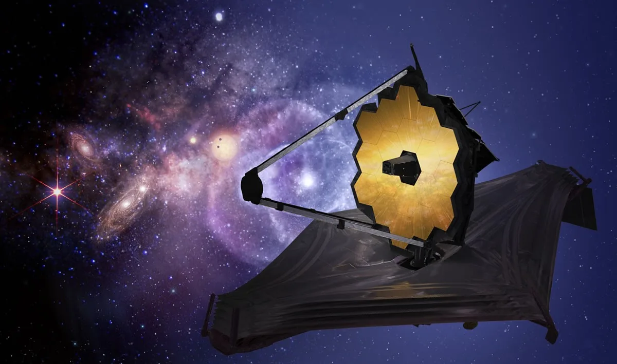
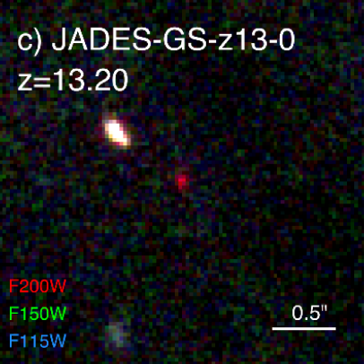
The Future
Dark Energy Domination
$$z=0.4$$
Most Distant Observed Quasar $$z=7.64$$
Most Distant Observed Galaxy $$z=13.2$$
Start of Galaxy Formation $$z≈20$$
Big Bang
Now
$$z=0$$
???
???
13.8 Bil. Yrs.
9.8 Bil. Yrs.
13 Bil. Yrs.
13.4 Bil. Yrs.
$≈$13.6 Bil. Yrs.
New Surveys + Telescopes
$→$ More Data
$→$ Clearer Picture of History

Slide 22
Thank You! Questions?
Website: https://hughmcdougall.github.io/
Email: HughMcDougallEmail@gmail.com
GitHub: https://hughmcdougall.github.io/
Twitter: https://twitter.com/HughMcD_Astro

