Slide 1
A Quick Quasar Quintroduction
Hugh McDougall, UQ Astro, Pint of Science 2024

Slide 2
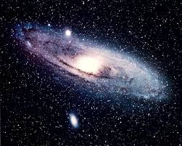
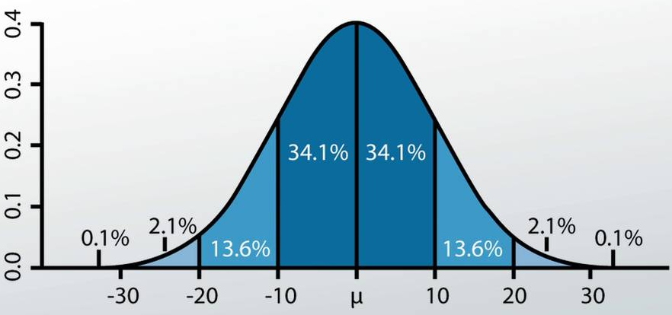
About Me: Hugh McDougall
Work In Industry +Covid
2013 - 2018
2021
2023
2026
Now
“Dr. Hugh”
Physics Degree + Aerospace Eng. Honours
Physics Honours
Astrophysics PhD
My Speciality: Astro-Statistics
Astronomy
Statistics

Slide 3
My Field of Work:
“Reverberation Mapping of High-Redshift Active Galactic Nuclei”
Today’s Topic:
“What The Hell Does That Mean?”

Slide 4
Show Of Hands: Who Knows These Words?
A
Quasar
Is an extremely large
Black Hole
In the middle of a
Galaxy

Slide 5
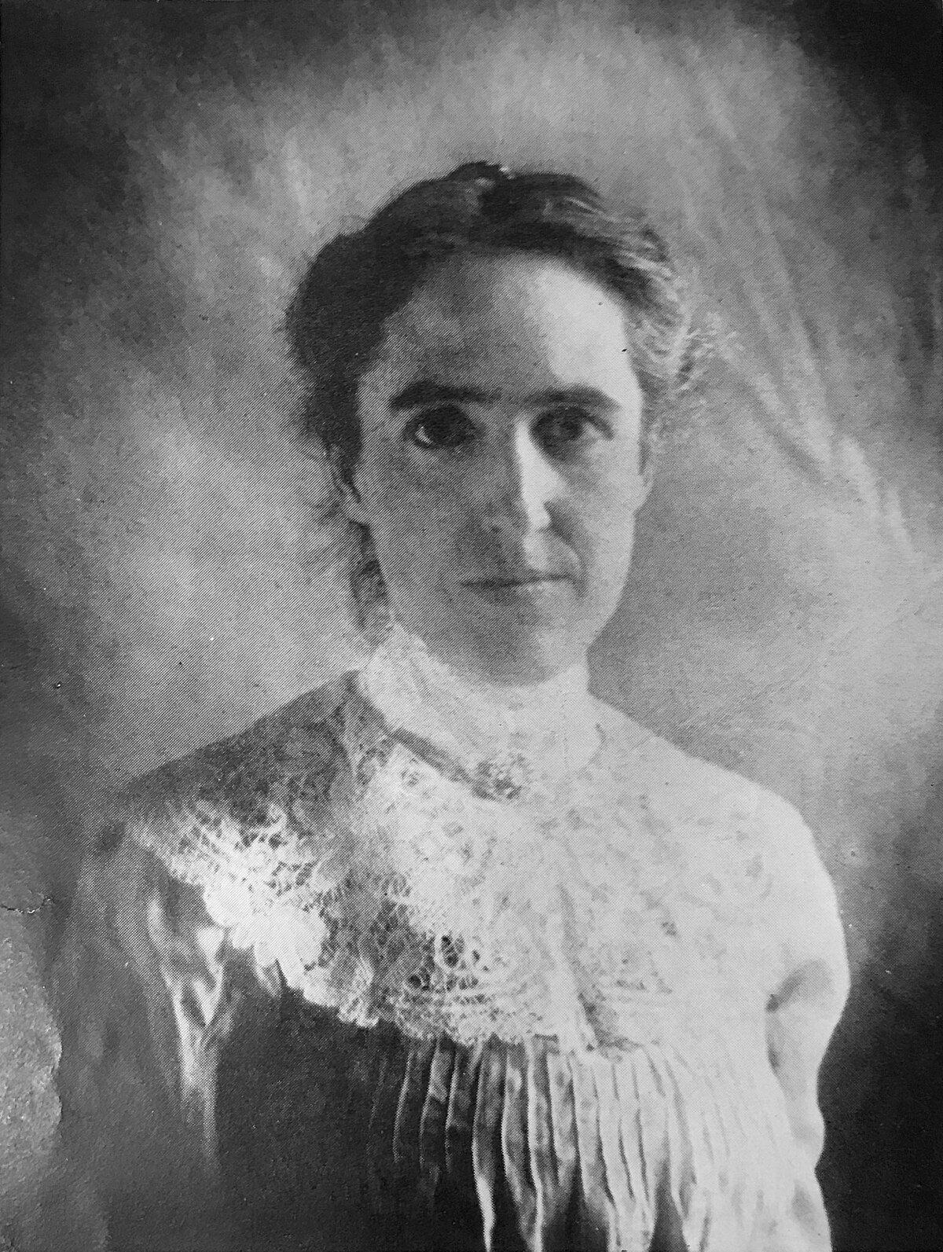
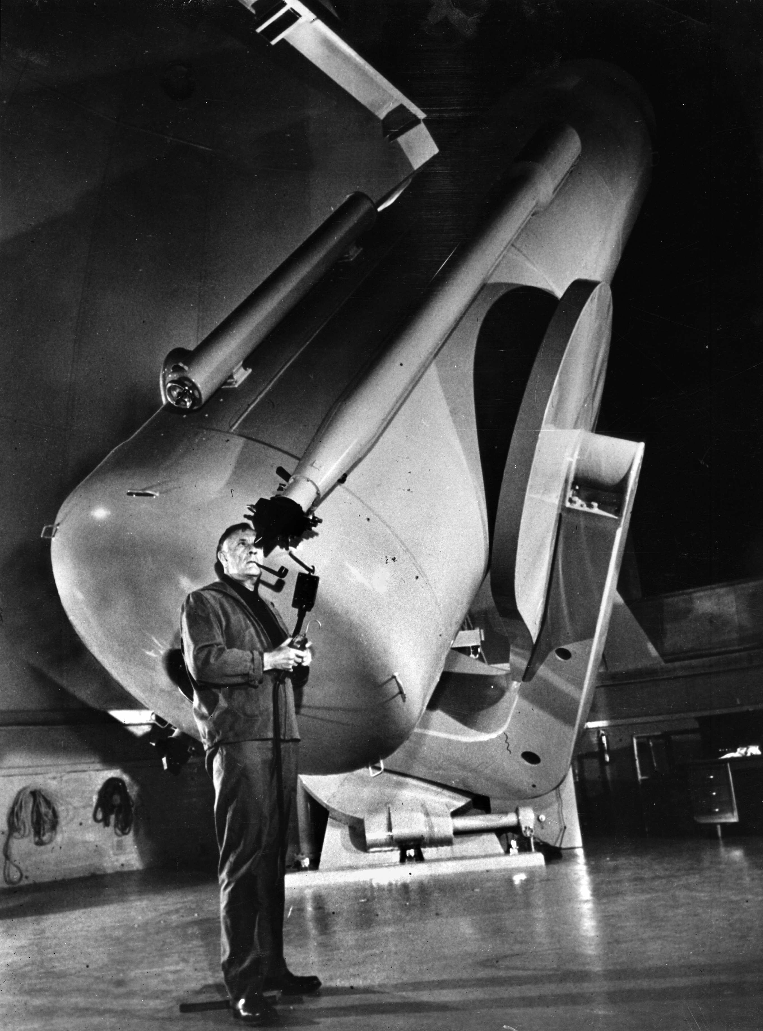
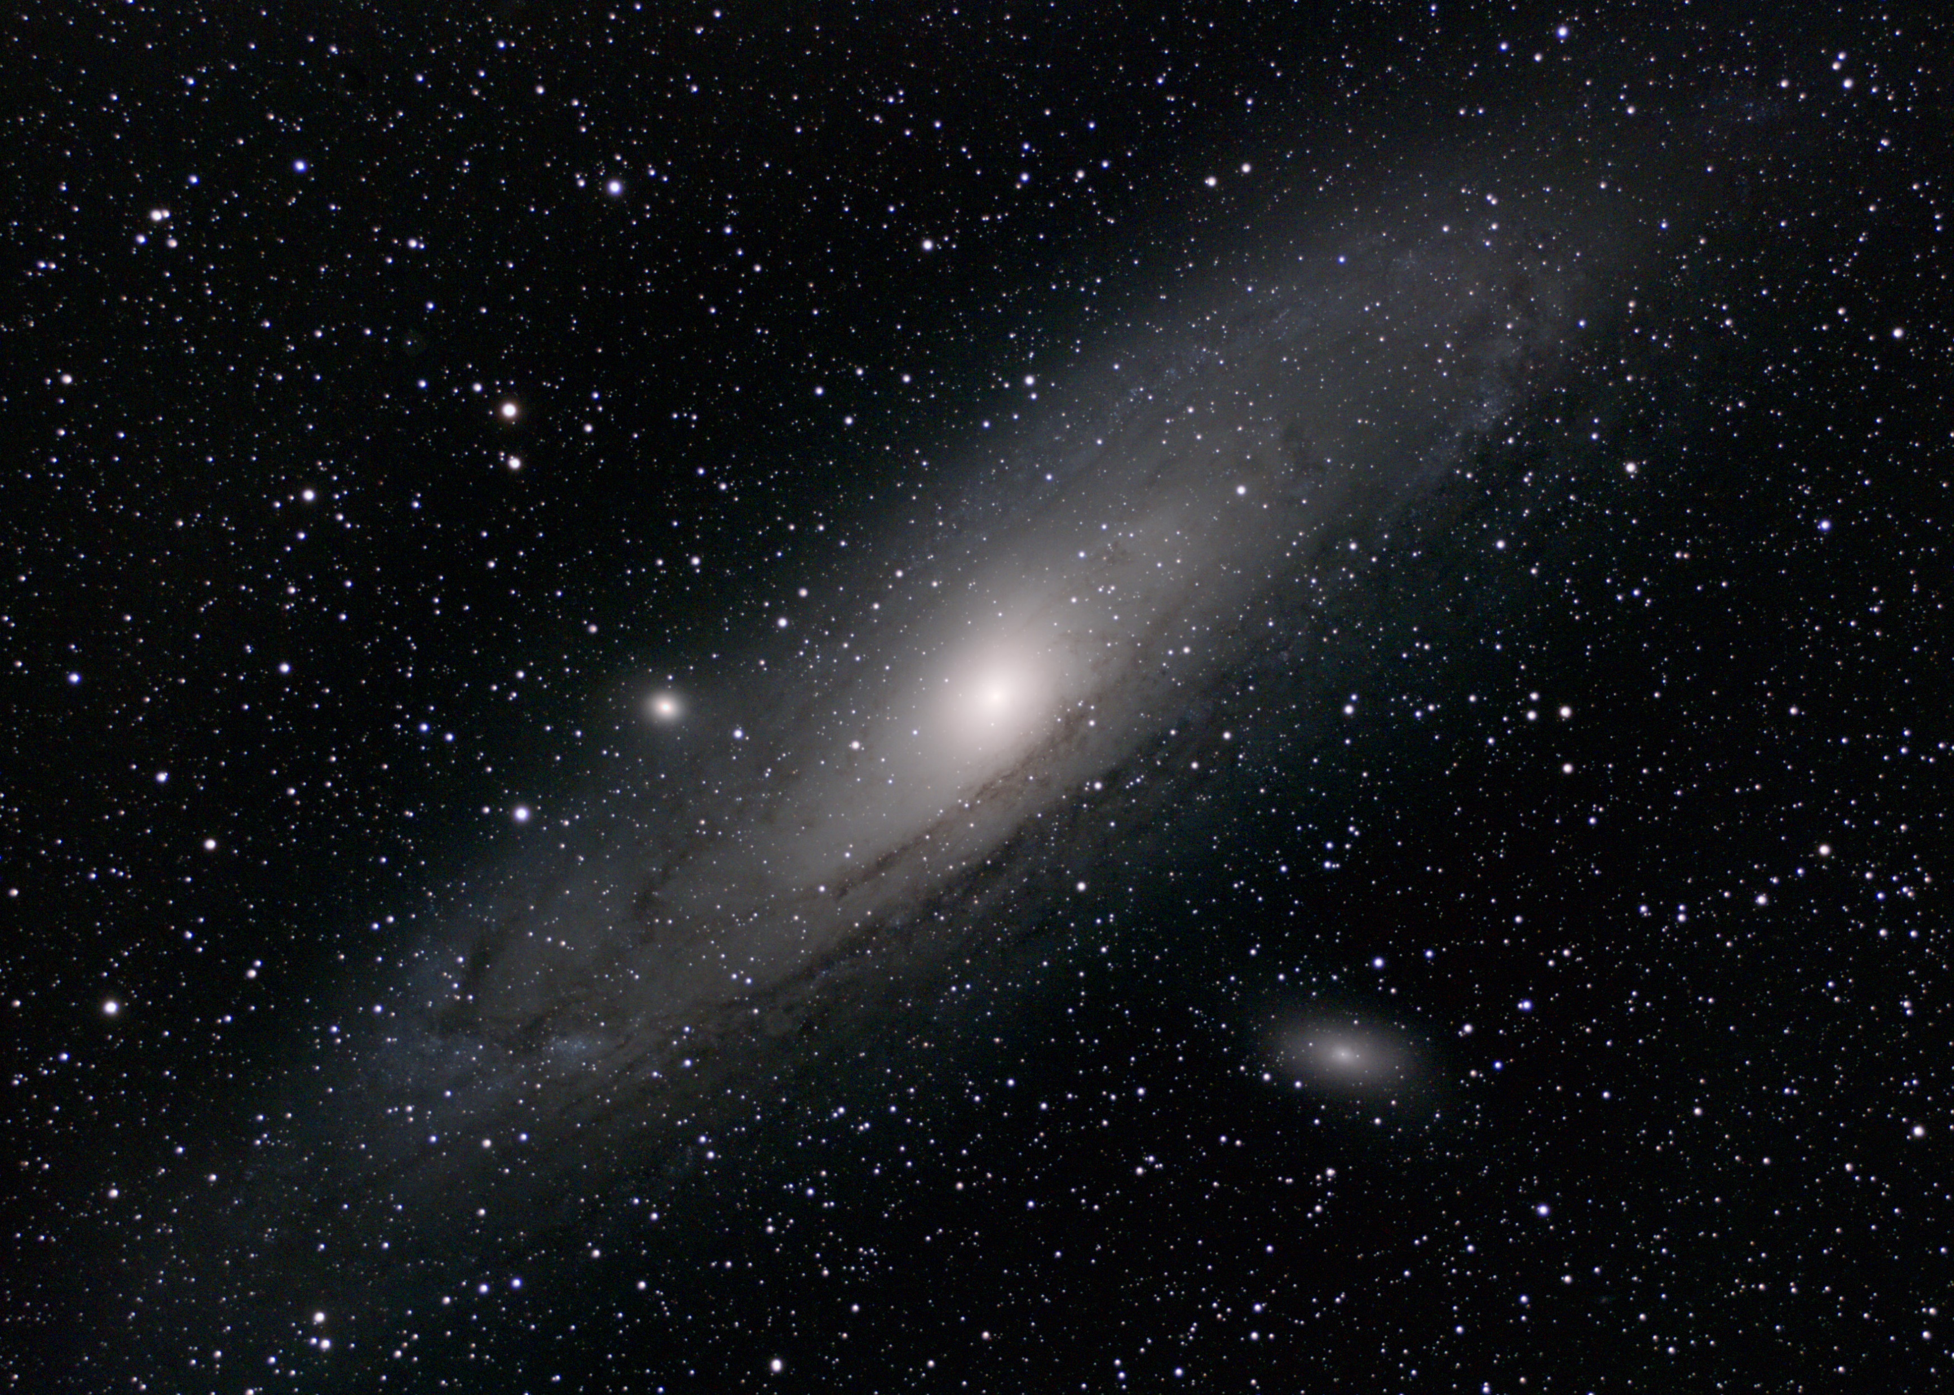
Early 20th Century: Lots of Big Changes To Our Understanding of Space
Henrietta Swann Leavitt:
Discovered Ruler for Galaxy Distance
1920’ Confirmation of other galaxies
1940’s The Universe is Expanding
Edwin Hubble at the Hooker Telescope, Mt Wilson Observatory, LA

Slide 6
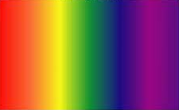
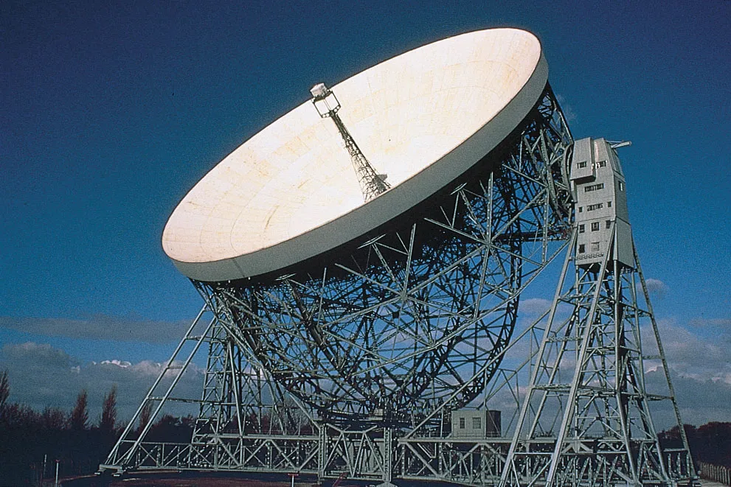
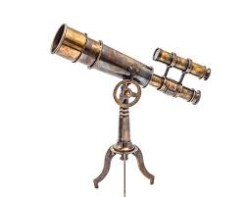
1930’s: Radio Telescopes
Infrared
Ultraviolet
Radio
Waves
X-Rays
Gamma Rays
Visible Light
$$Naked eye⇒ Telescopes$$
$$Telescopes⇒ Big Telescopes$$
$$Big Telescopes⇒ Fancy Telescopes$$
Radio Telescope
Optical Telescope

Slide 7
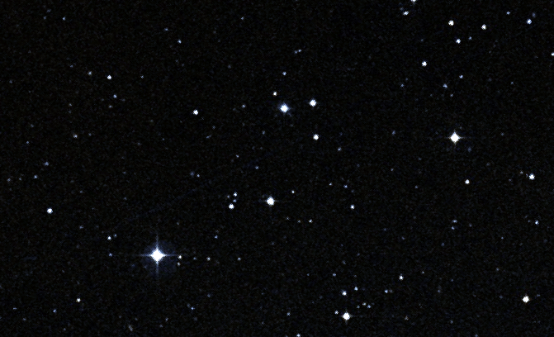
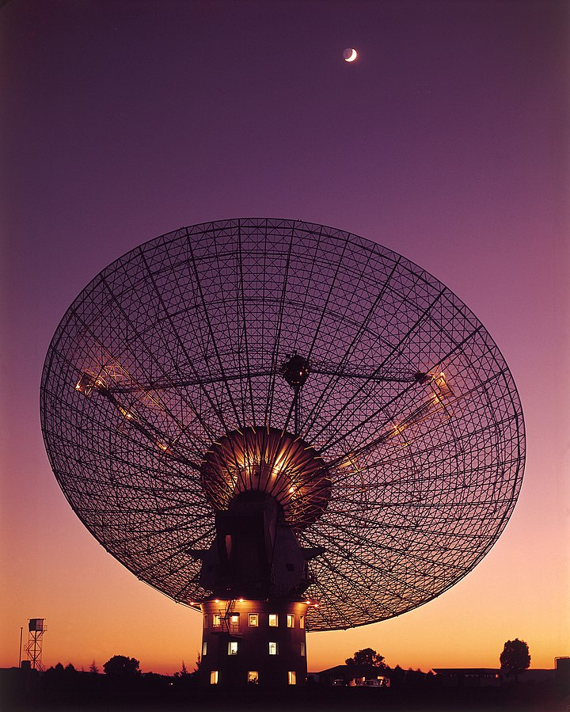
1960’s: The Search for a “Radio Galaxy”
Loud Radio Source Somewhere In Here
Parkes Radio Telescope, NSW

Slide 8
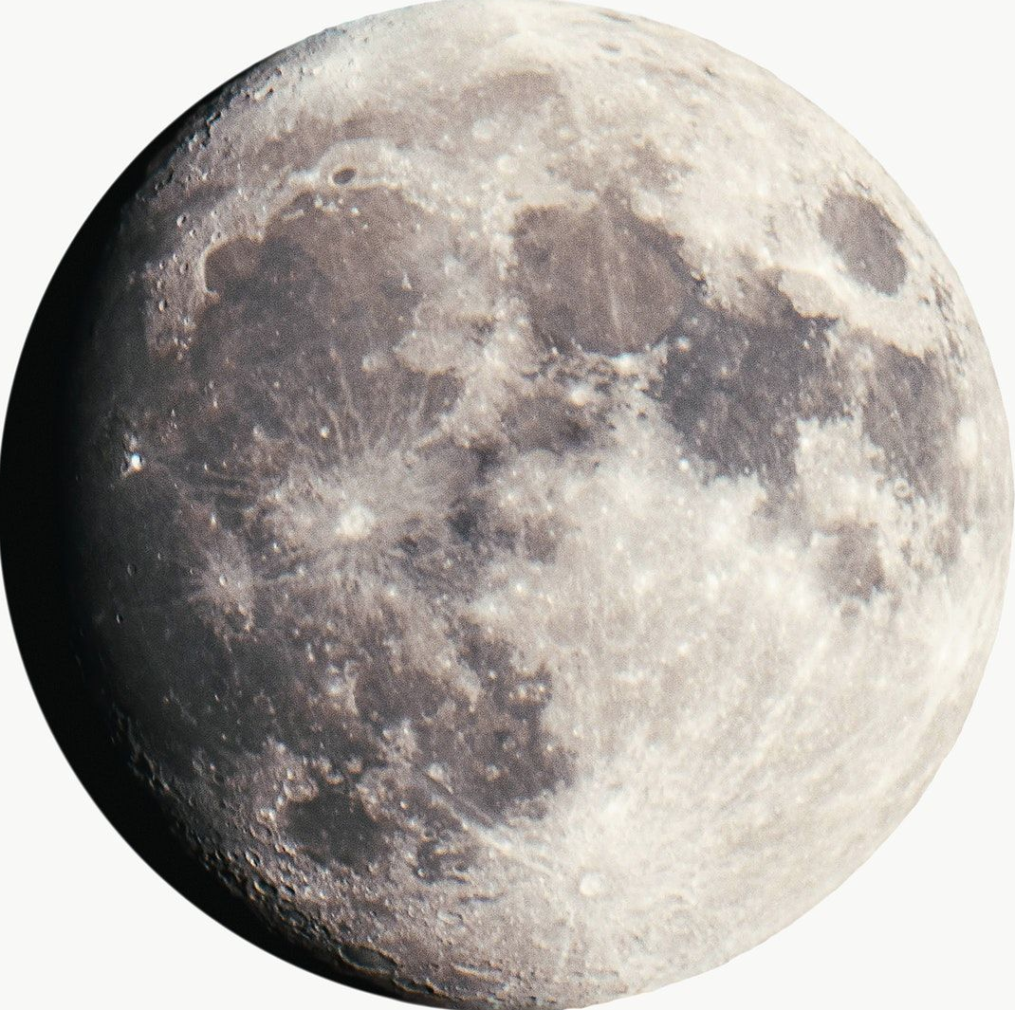
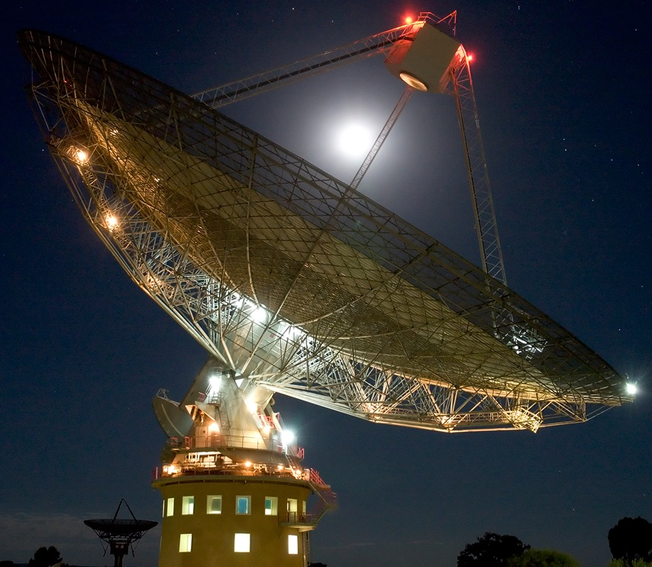
Lunar Occultation
Moon moves out of the way front: Signal Turns Back On
Previous Best Position Range
Moon moves in front: Signal Turns Off

Slide 9
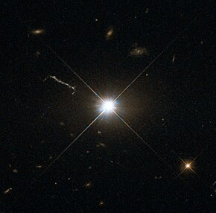
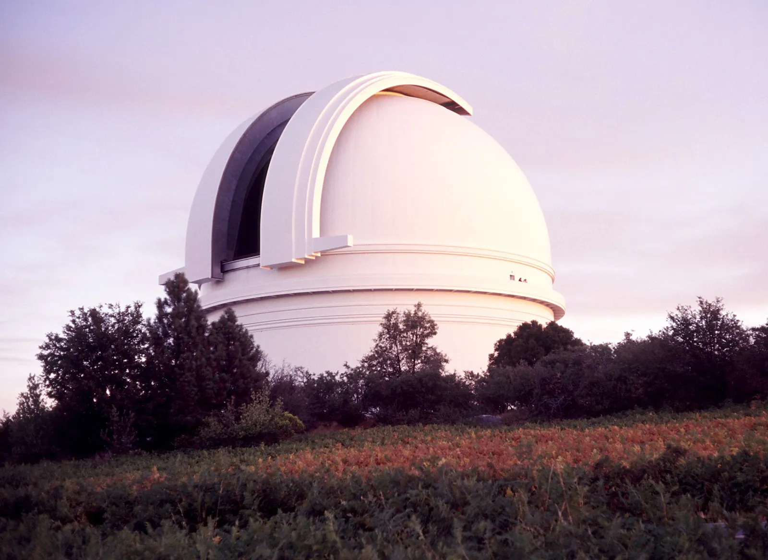
3C-273 - Looks Like a Star, but…
Fast?
Distant!
Bright?
Galaxy!
Small?
?
Quasi Stellar Radio Source
Quasar
Hale Telescope, Palomar Observatory

Slide 10
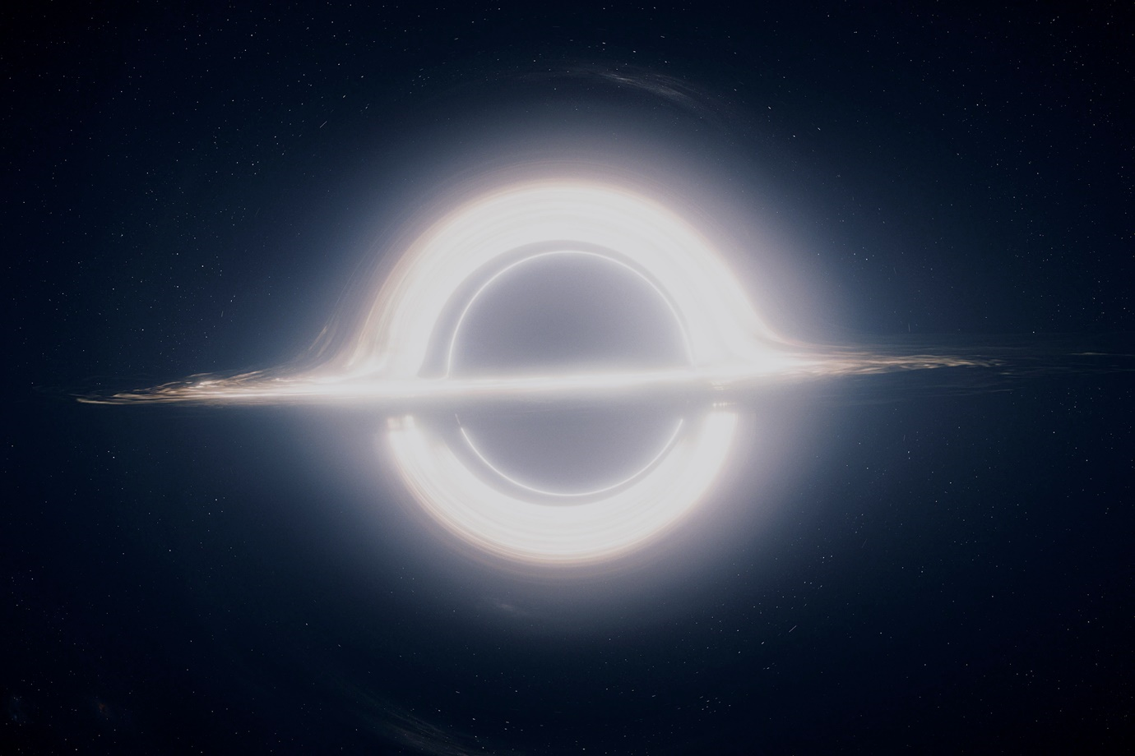
The Answer: A Super-Massive Black Hole
Simulation of a super-massive black hole from Interstellar (2014)
886 million times heavier than the sun
2.4 Billion Light Years Away ($≈1000×$ distance to nearest Galaxy)
Matter sucked in, compacted into white-hot disk
Vortex jets blast radio signals out
Artist's rendition of a zoomed-out quasar and its surrounding dust clouds

Slide 11
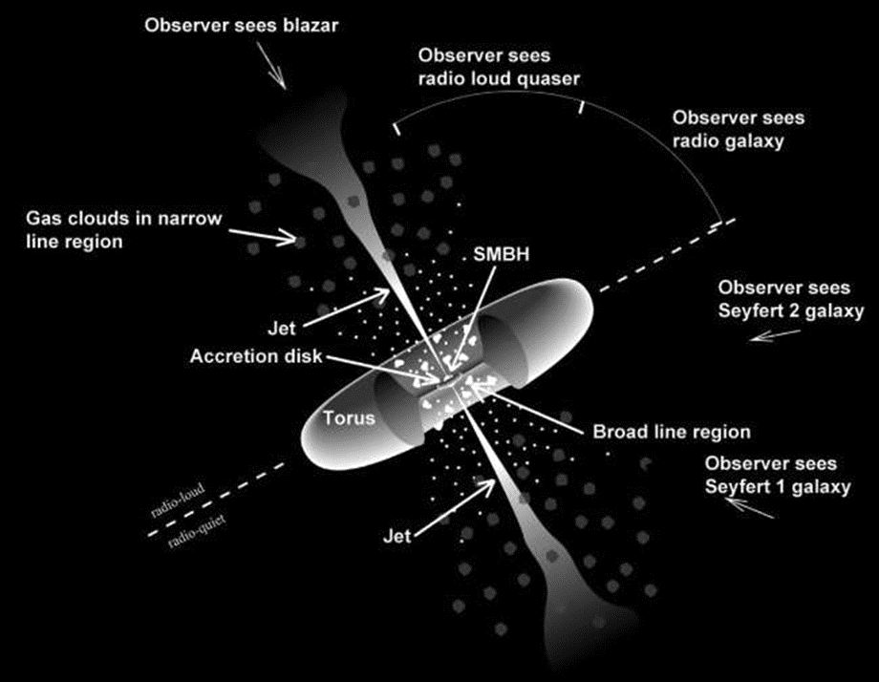
AGN – One Answer to Many Questions
Answered a lot of questions:
Quasars
Blazars Radio jet coming directly at us
Seyfert galaxies Glowing reflection of a quasar through a dust cloud
Radio galaxy: Can only see the radio-jets
Every galaxy has an SMBH, including the milky way

Slide 12
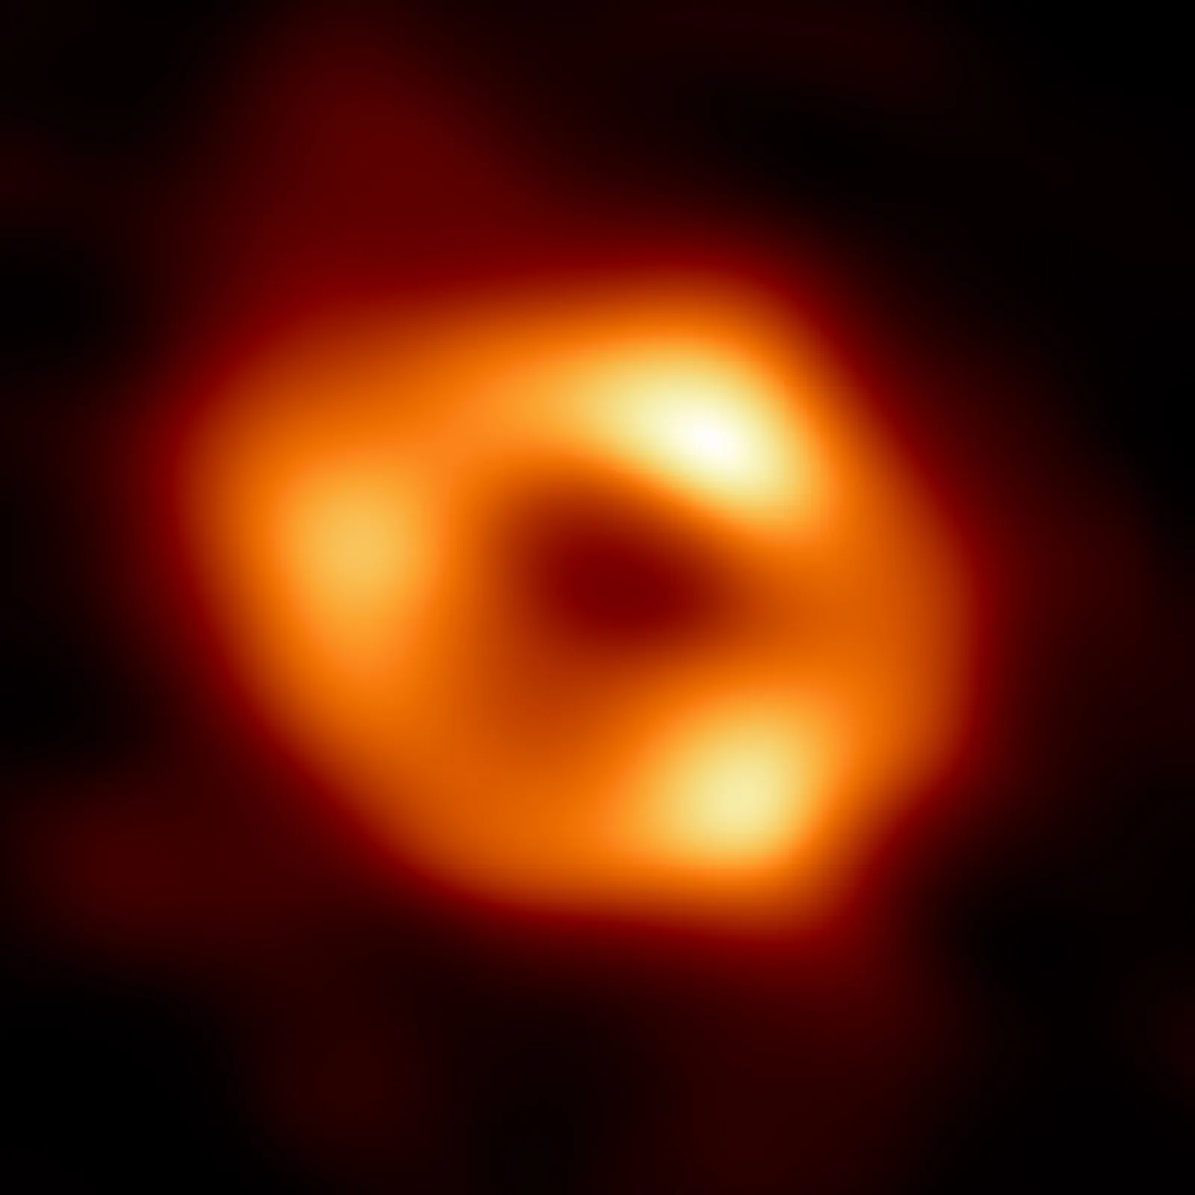
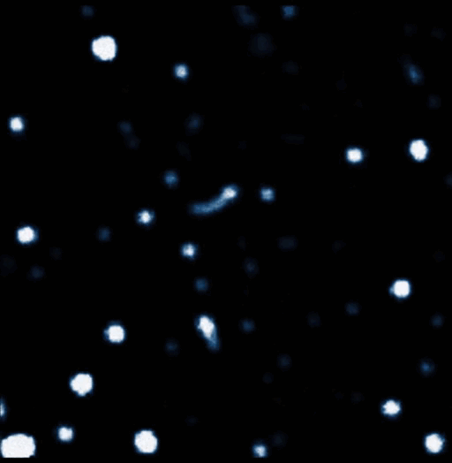
Sagittarius A*: Our Local SMBH
Photograph of Sgr A* (Event Horizon Telescope, 2022)
4.3 billion times heavier than the sun
Currently dormant, not a bright shining thing
Not going to eat us
Still only <1% of the Milky Way’s mass
≈27,000 light-years
Stars Tugged by the Gravity of Sgr A*

Slide 13
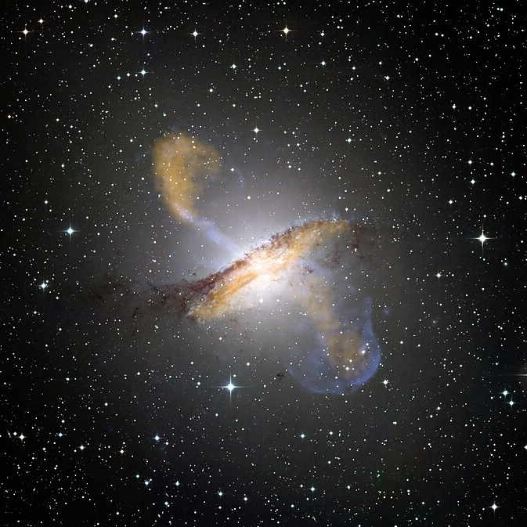
Why we Care #1 AGN are “vital organs” to galaxy formation
Light pushes out, slows galaxy down
Quasars tell us how galaxies form and grow

Slide 14
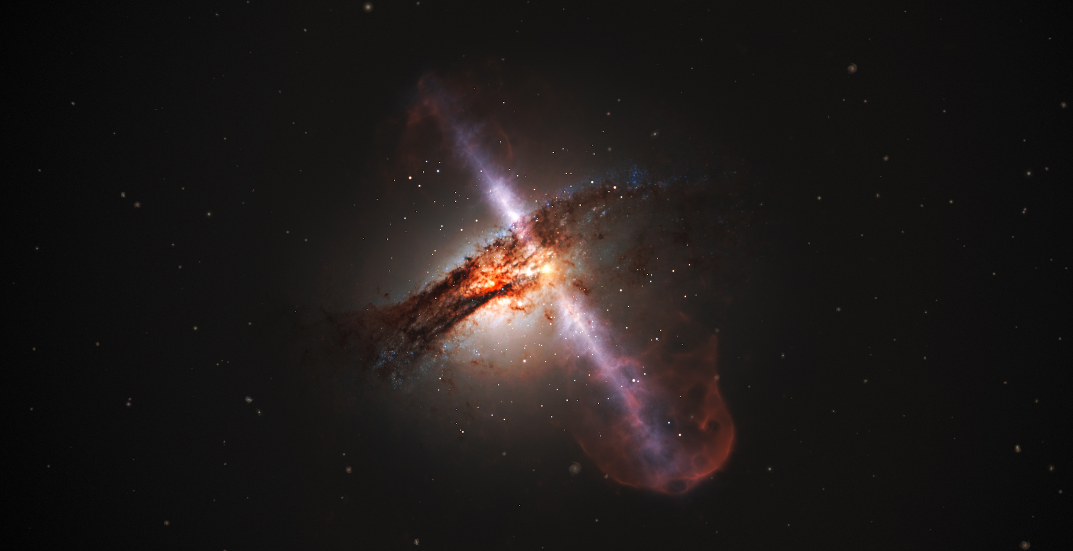
Why we Care #2 When we look out into space we also look back in time
Quasars are bright enough to see very far away

Slide 15
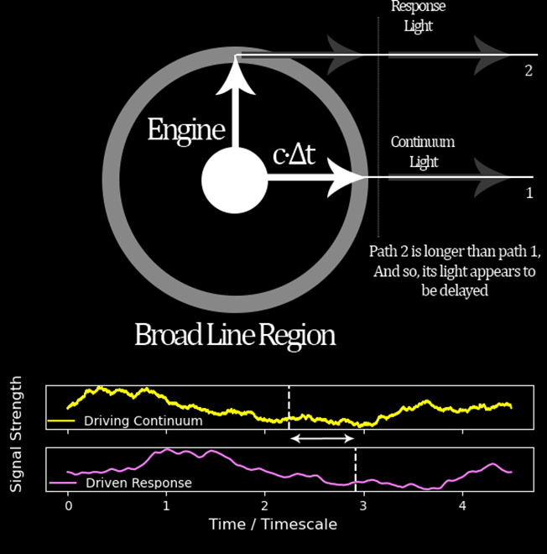
My Work: Reverberation Mapping
Distant quasars too small to see details
Can use light echoing around inside as a ruler
Can measure black hole masses out to incredible distances

Slide 16
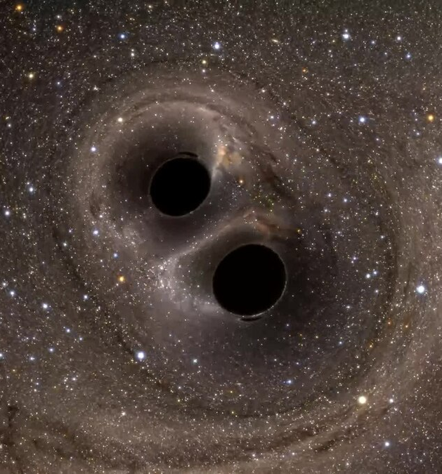
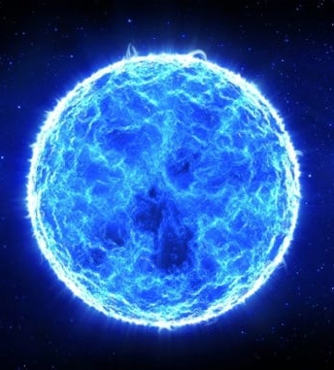
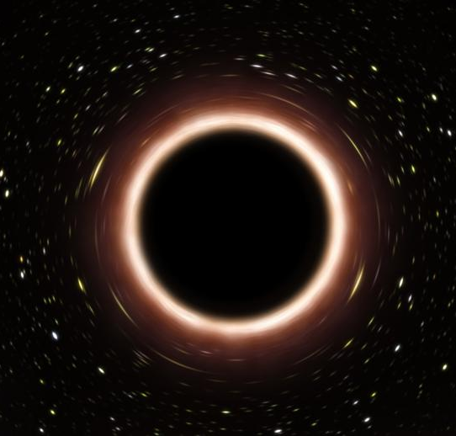
Why we Care #3 Still open questions about how SMBH’s form
Small Black Holes Merging?
Giant Ancient Stars?
Primordial Black Holes?

Slide 17
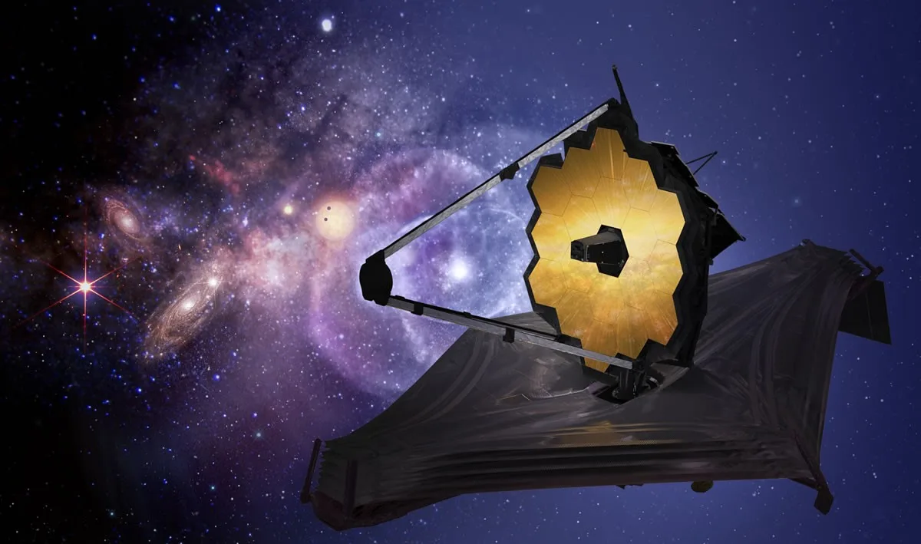
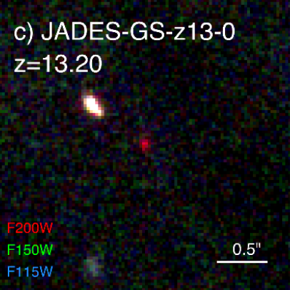
The Future
Dark Energy Domination
$$z=0.4$$
Most Distant Observed Quasar $$z=7.64$$
Most Distant Observed Galaxy $$z=13.2$$
Start of Galaxy Formation $$z≈20$$
Big Bang
Now
$$z=0$$
???
???
13.8 Bil. Yrs.
9.8 Bil. Yrs.
13 Bil. Yrs.
13.4 Bil. Yrs.
$≈$13.6 Bil. Yrs.
?

Slide 18
Thank You! Questions?
Website: https://hughmcdougall.github.io/
Email: HughMcDougallEmail@gmail.com
GitHub: https://hughmcdougall.github.io/
Twitter: https://twitter.com/HughMcD_Astro

