Slide 1
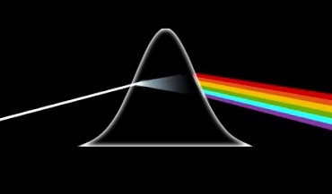
Statistical Methods: Important But Not Scary
Hugh McDougall, PhD Student at UQ
OzGrav ECR Workshop, Dec 10 2024
Notes:
Find a catch image

Slide 2
Today’s Talk
Part 1
Why stats methods matter
Part 2
The Main Bayesian Stats Methods:
MCMC
Nested Sampling
Part 3
How to choose the right tool for your job
Notes:
- Add visual flare
- Keep positive

Slide 3
Part 1 Stats Methods Are Important

Slide 4
The Hierarchy of Modelling
The Numerical Blindspot
Physics Model
What are we seeing?
Statistics How do we describe this with maths?
Numerics
How do we calculate this?
Results What does this tell us?

Slide 5
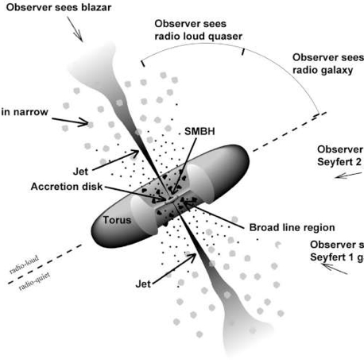
A Cautionary Tale from Reverberation Mapping
Super-Massive black holes at the core of distant galaxies
We want to know masses, tells us about
Primordial universe
Galaxy evolution
BH mergers
Problem: Small, dark, far away
Solution: Super-bright accretion disks from Active Galactic Nuclei
arXiv:astro-ph/9506063
Notes:
This is cool and interesting

Slide 6
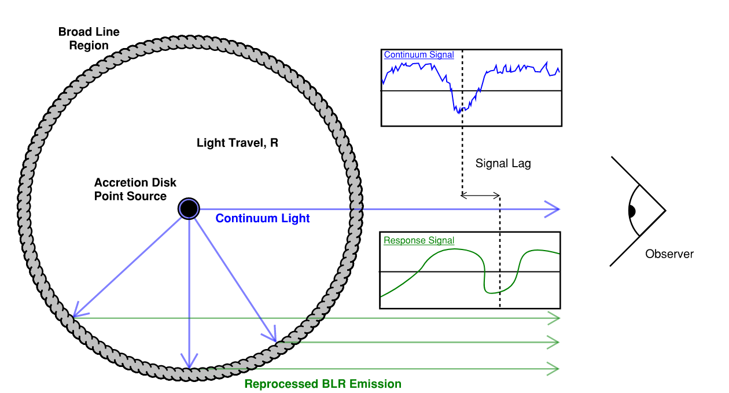
My Work: Reverberation Mapping
Accretion disk flickers
Flickers “echo” off cloud as doppler broadened lines
Lag of echo is ruler for system size
$$R_{BLR}=c⋅Δt$$
$$R=c⋅Δt$$
Notes:
Reverse graph so eye is on left. Flip lightcurves to be temporally correct (add for paper as well)
More lean on DRW’s

Slide 7
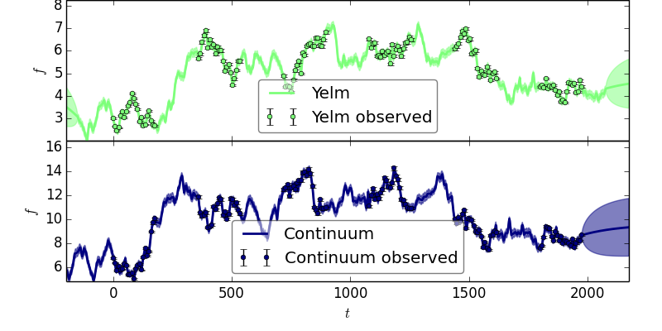
10 Yrs Ago: Problem Solved with JAVELIN
Zu, 2013
arXiv:1202.3783
Physics Model
Single lag that gives BLR radius:v
$$R_{BLR}=c⋅Δt$$
Statistics
Bayesian Generative Model + Gaussian Processes
Numerics
Bayesian Fitting with emcee
arXiv:1202.3665
Results AGN Lag + BLR Radius

Slide 8
What’s Changed?
Modern RM is done with Industrial Scale multi-year surveys (e.g. OzDES, SDSS) that suffer from the problem of aliasing
True
Peak
Aliasing
Peak
JAVELIN
Multiple Peaks in Lag Posterior Distribution
Seasonal Gaps in Data

Slide 9
Bad Results Carry Onwards

Slide 10
The OzDES Solution
Tune selection criteria based on simulations and apply stringent quality cuts. (Penton 2021, Malik 2023, Yu 2021, Yu 2023)
Lags Measured: 763
Lags Retained After Cuts: 64
~92% Of Sources Discarded

Slide 11
JAVELIN gets it Wrong
Lag Posterior Distribution from JAVELIN
Same Data
Same Physics
Same Statistics
Different Fitting Method
No Aliasing Peaks
True Lag Posterior Distribution

Slide 12
What Went Wrong?
JAVELIN does fitting with emcee – we can check the paper by Foreman-Mackey, 2015
emcee doesn’t work for multimodal distributions!
Aliasing problem falls into the numerical blind-spot

Slide 13
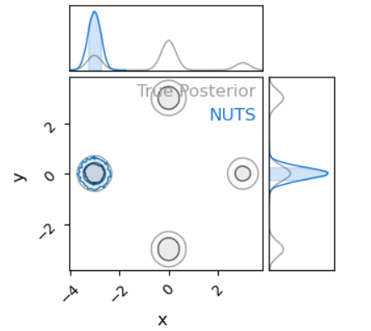
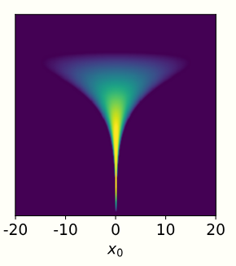
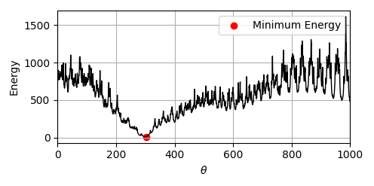
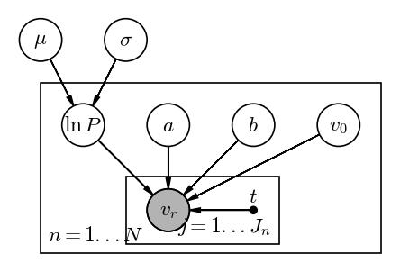
The Four Dangers of Bayesian Fitting
Multimodality
Non-Gaussianity
Rough Geometry
High Dimensionality

Slide 14
Part 2 Stats Methods Aren’t Scary

Slide 15
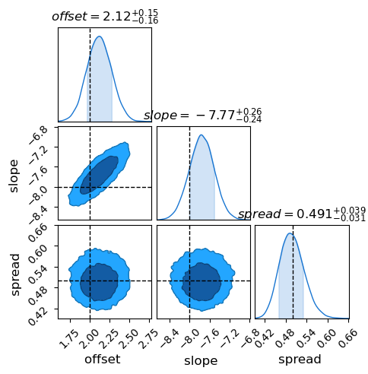
Bayesian Fitting
Prior – What we knew before we got our data
Posterior Density: $P\left(θ\right) ∝ L\left(θ | D\right) × π\left(θ\right)$
Likelihood – What Our Data Tells us
Optimization
Find “Best Fit”
Exploration
Constrain Parameters
Evidence
Compare Models
$$Z =∫P\left(θ\right) dθ$$

Slide 16
The Bayesian Methods Family Tree
Too Simple
Speciality Topics
Information
Criteria
Markov Chain
Monte Carlo (MCMC)
Nested
Sampling
Fancy Stuff
AIC
BIC
DIC
Hamiltonian
Monte Carlo (HMC)
Dynamic Nested
Sampling
Stochastic Variational Inference
Simulated Bayesian Inference
Parameter Constrain | Model Comparison
Parameter Constrain | Model Comparison
Parameter Constrain | Model Comparison

Slide 17
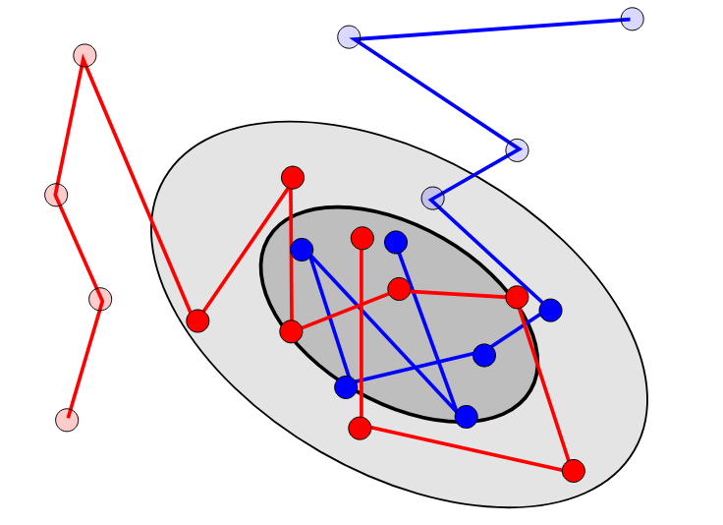
MCMC - Markov Chain Monte Carlo
Work-horse of Astro-Statistics
A family of samplers
Can’t / Shouldn’t be used for
Integration / Model Comparison
Optimization
Draws samples proportional to the Bayesian posterior density
Started with the Metropolis-Hastings Algorithm
Who knows how this was invented?

Slide 18
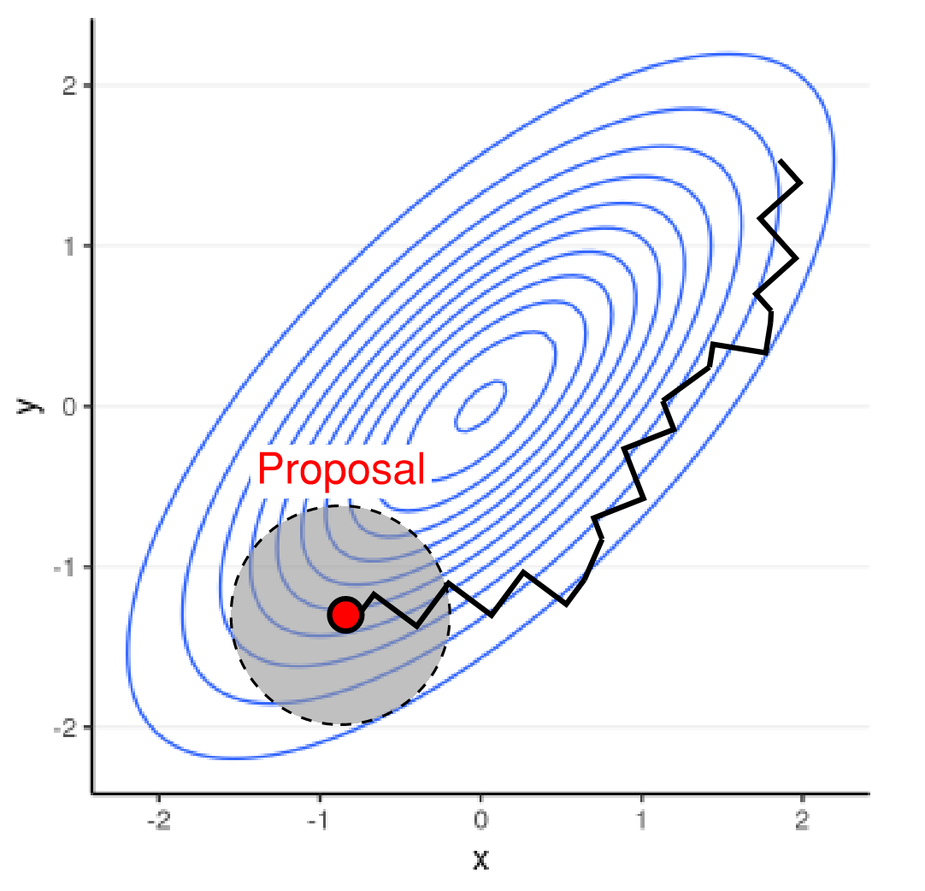
The Metropolis Algorithm: Statistical Mechanics!
Lots of states / positions, $\left\{θ\right\}$, each with energy $E\left(θ\right)$
Probability a state is occupied from Boltzmann Distribution:
$$P\left(θ\right)∝e^{−\frac{E\left(θ\right)}{k_{B}T}}$$
Start at random position $θ_{1}$
‘Propose’ A nearby state to move to, $θ_{2}$
Energy Lower? Go!
Energy Higher? Maybe move: $p_{θ_{1}→θ_{2}}∝e^{−\frac{ΔE}{k_{B}T}}$
Repeat until you’ve mapped the important states

Slide 19
Metropolis Hastings Algorithm
Metropolis Algorithm
Physical Energies $→$ Probabilities
$$P\left(θ\right)∝e^{−\frac{E\left(θ\right)}{k_{B}T}} → E\left(θ\right)=\ln\left|P\left(θ\right)\right|$$
Metropolis Hastings Algorithm
Imaginary Energies $←$ Probabilites

Slide 20
Hamiltonian Monte Carlo (HMC)
Potential Energy Landscape + Gradient = Force
$$\vec{F}\left(θ\right)=∇E\left(θ\right)$$
Forces $→$ Momentum $→$ Kinetic Energy
MCMC: Particle “Hopping” Around
HMC: Projectile “Orbiting” Around
Can do MCMC-Chains for thousands of parameters
Work ‘out of the box’ with AutoDiff languages
arXiv:1701.02434

Slide 21
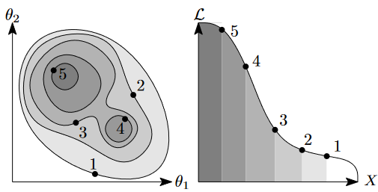
Nested Sampling
Newer than MCMC (from Skilling, 2004)
Integrates and samples
Slower than MCMC and scales worse in higher dimensions
Seeing lots of fancy improvements over the last few years
arXiv:1506.00171v1

Slide 22
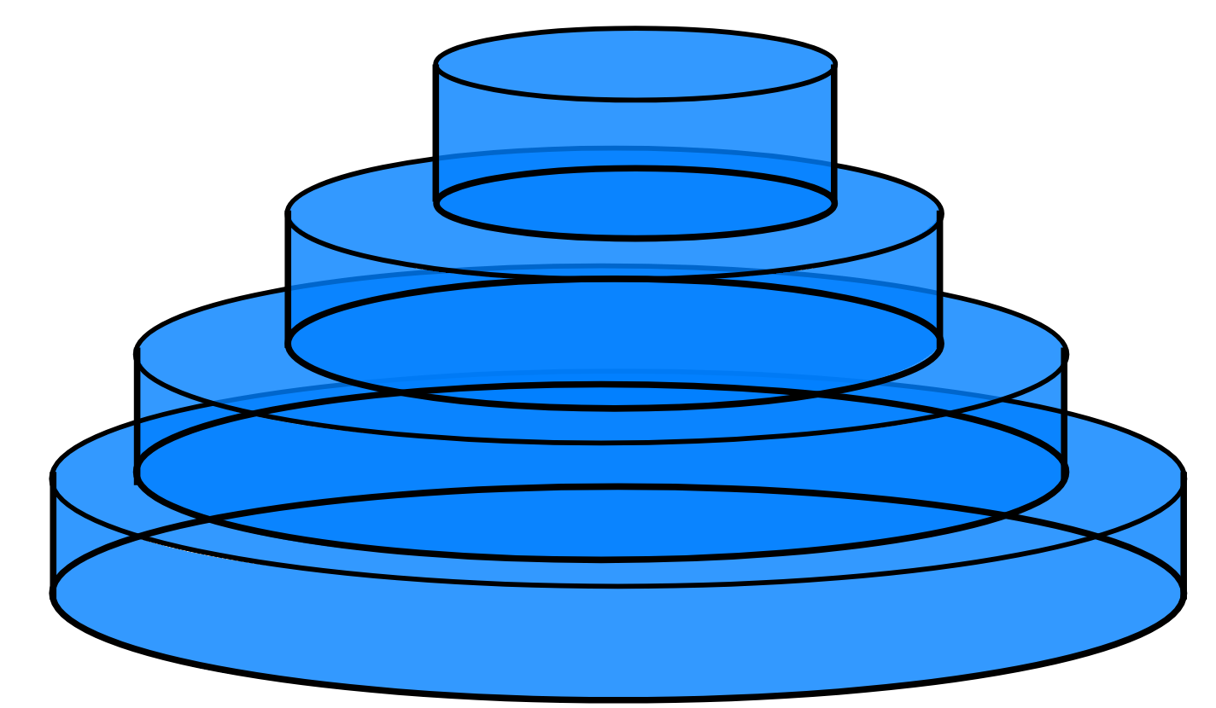
Nested Sampling – Lebesgue Integrals
Riemann Integral Chunks of known area, estimate of height
Lebesgue Integral Plates of known height, estimate of Area

Slide 23
Nested Sampling – How it Works
V = 1.0
Unit Square / Cube
Known “Volume”, $V_{0}=1.0$
Thrown down uniform sample of “live points” (Here, $15$ of them)
Calculate the density at each point and order them from worst to best
$$x_{4}$$
$$x_{16}$$
$$x_{5}$$
$$x_{3}$$
$$x_{12}$$
$$x_{10}$$
$$x_{15}$$
$$x_{6}$$
$$x_{11}$$
$$x_{13}$$
$$x_{14}$$
$$x_{8}$$
$$f(x_{15})$$
$$f(x_{14})$$
$$x_{2}$$
$$f(x_{13})$$
$$x_{9}$$
$$f(x_{12})$$
$$x_{7}$$
$$f(x_{11})$$
$$f(x_{10})$$
$$x_{1}$$
$$f(x_{9})$$
$$f(x_{8})$$
$$f(x_{7})$$
$$f(x_{6})$$
$$f(x_{5})$$
$$f(x_{4})$$
$$f(x_{3})$$
$$f(x_{2})$$
$$f(x_{1})$$

Slide 24
Nested Sampling – How it Works
V = 1.0
Find worst point and “kill” it, making a “dead point”
$\frac{1}{15}$ points were killed
$⇒ ≈\frac{1}{15}$ of volume is at $f\left(x\right)<f\left(x_{1}\right)$
Known height - $f\left(x_{1}\right)$
Known volume $V≈\frac{1}{15}$
$$x_{4}$$
$$x_{16}$$
$$x_{5}$$
$$x_{3}$$
$$V≈\frac{14}{15}$$
$$x_{12}$$
$$x_{10}$$
$$x_{15}$$
$$x_{6}$$
$$x_{11}$$
$$x_{13}$$
$$x_{14}$$
$$x_{8}$$
$$f(x_{15})$$
$$f(x_{14})$$
$$x_{2}$$
$$f(x_{13})$$
$$x_{9}$$
$$f(x_{12})$$
$$x_{7}$$
$$f(x_{11})$$
$$f\left(x\right)>f\left(x_{1}\right)$$
$$f(x_{10})$$
$$V≈\frac{1}{15}$$
$$x_{1}$$
$$f(x_{9})$$
$$f\left(x\right)<f\left(x_{1}\right)$$
$$f(x_{8})$$
$$f(x_{7})$$
$$f(x_{6})$$
$$f(x_{5})$$
$$f(x_{4})$$
$$f(x_{3})$$
$$f(x_{2})$$
$$f(x_{1})$$
$$V≈\frac{1}{15}$$

Slide 25
Nested Sampling – How it Works
V = 1.0$×\left(1−\frac{1}{15}\right)$
Draw a replacement point
Same as before: known volume ($≈\frac{1}{{15}^{th}}$ less than start before)
Sort points from worst to best
Create another Lebesgue plate
$$x_{3}$$
$$x_{16}$$
$$x_{4}$$
$$x_{2}$$
$$x_{11}$$
$$x_{9}$$
$$x_{15}$$
$$x_{6}$$
$$x_{12}$$
$$x_{10}$$
$$x_{13}$$
$$x_{14}$$
$$x_{8}$$
$$f(x_{15})$$
$$f(x_{14})$$
$$x_{1}$$
$$f\left(x\right)>f\left(x_{1}\right)$$
$$f(x_{12})$$
$$f(x_{13})$$
$$x_{8}$$
$$f(x_{11})$$
$$x_{7}$$
$$f(x_{10})$$
$$f(x_{9})$$
$$f\left(x\right)<f\left(x_{1}\right)$$
$$f(x_{8})$$
$$f(x_{7})$$
$$f(x_{6})$$
$$f(x_{5})$$
$$f(x_{4})$$
$$f(x_{3})$$
$$f(x_{2})$$
$$f(x_{1})$$

Slide 26
Nested Sampling – How it Works
V = 1.0$×{\left(1−\frac{1}{15}\right)}^{n}$
Repeat again and again
Build up smaller and smaller plates until we’ve covered all of the ‘mass’
$$x_{1}$$
$$f(x_{15})$$
$$f(x_{1})$$

Slide 27
Nested Sampling Vs MCMC
MCMC | Nested Sampling
Differ in proposal methods | Differ in replacement point method
Usually bad at multimodal distributions | Usually good at multimodal distributions
Exploration / Sampling only | Exploration / Sampling & Integration
Typically scale well into low 10’s of dimensions | Becomes rapidly more expensive for complex models
Can keep running longer for higher precision | Fixed end condition

Slide 28
Part 3 How to Choose a Tool

Slide 29
The Four Dangers of Bayesian Fitting
Multimodality
Non-Gaussianity
Rough Geometry
High Dimensionality

Slide 30
You don’t need to know everything!
Notes:
You dont

Slide 31
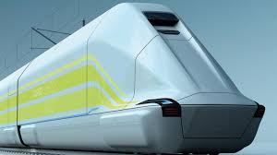
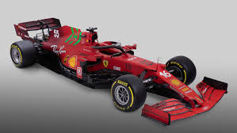
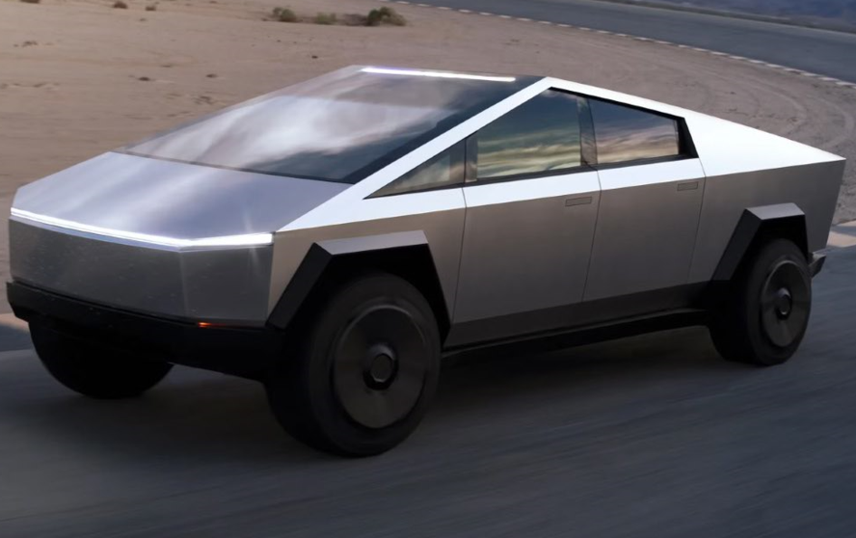
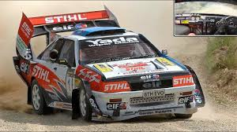
An Analogy - Cars
Nested Sampling
Multi-Modality
SVI /w Gaussian Mixture Models
Annealed AEIS
emcee
HMC
High Dimensions
+
Non- Gaussian
Rough Geometry
Barker Metropolis-Hastings

Slide 32
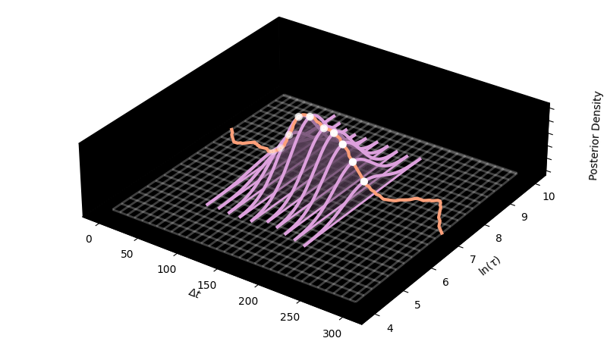
My Work: LITMUS
Bayesian RM Lag Recovery + Evidence Calculation
$≈10×$ Faster than Nested Sampling
Handles all the problems of Reverberation Mapping:
Multimodality
Rough Geometry
Non-Gaussianity
Modular: can be used for more complex stats

Slide 33
Summary
Part 1
Stats methods are crucial to our science: If they go wrong our science breaks
Part 2
MCMC – Navigate around an energy function
Nested Sampling – Walk up hill and track the area underneath you
Part 3
How to choose the right tool:
What job am I trying to do? Constraint / Comparison?
What failure modes are there? What tools can handle them?
Notes:
- Add visual flare
- Keep positive

Slide 34
Thank You. Questions?
Website: https://hughmcdougall.github.io/
Email: HughMcDougallEmail@gmail.com
GitHub: https://hughmcdougall.github.io/
Twitter: https://twitter.com/HughMcD_Astro

